Slide 1
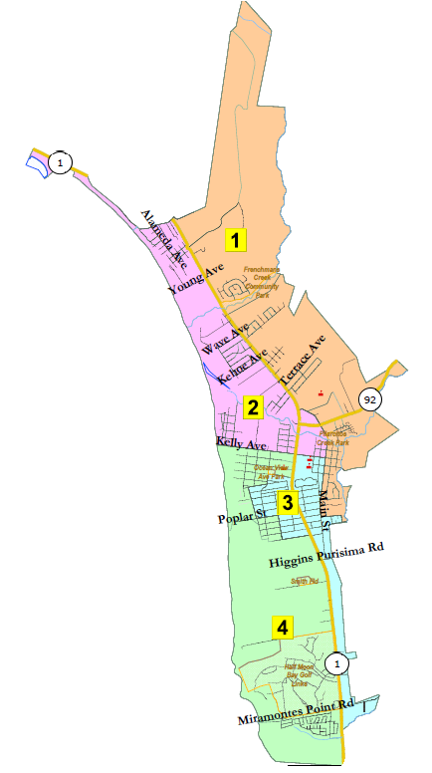
City of Half Moon Bay Introduction to Redistricting
Shalice Tilton, Sr. Consultant
National Demographics Corporation

Slide 2
Step | Description
Workshops (RAC) Aug. 12 & Aug. 19 | Education and to solicit input on the communities in the Districts.
Two Pre-Map Hearings (RAC) Aug. 26 & Sept. 2 | Held prior to release of draft maps. Education and to solicit input on the communities in the Districts.
Census Data Release Aug. 12 | Census Bureau releases official 2020 Census population data. The data will be in legacy format and must be reformatted.
California Data Release Oct. | California Statewide Database releases ‘prisoner-adjusted’ 2020 redistricting data, then three-week waiting period to release maps.
Map Submission Deadline Oct. 28, 5 p.m. | The City’s demographer will professionally produce submitted maps and prepare a demographic summary for each map.
Review Draft Maps (RAC) Nov. 8 & Dec. 16 | Review and revise the draft maps and to select focus maps.
Workshop (RAC) Jan. 8 | Solicit input on focus maps.
Post-Map Hearing (CC) Jan. 19 | First public hearing to discuss and revise the draft maps and to discuss the election sequence.
Workshops (RAC) Jan. 22 & Jan. 27 | Solicit input on focus maps.
Post-Map Hearing (CC) Feb. 15 | Second public hearing to discuss and revise the draft maps and to discuss the election sequence.
Map Adoption (CC) Mar. 15 | Final map must be posted at least 7 days prior to adoption. Map adopted via ordinance. Deadline to adopt: Apr. 17, 2021

Slide 3
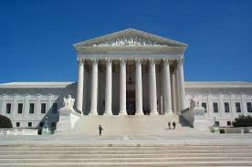
Redistricting Rules and Goals
1. Federal Laws
2. California Criteria for Cities
3. Other Traditional Redistricting Principles
Equal Population
Federal Voting Rights Act
No Racial Gerrymandering
Geographically contiguous
Undivided neighborhoods and “communities of interest” (Socio-economic geographic areas that should be kept together)
Easily identifiable boundaries
Compact (Do not bypass one group of people to get to a more distant group of people)
Prohibited: “Shall not favor or discriminate against a political party.”
Minimize voters shifted to different election years
Respect voters’ choices / continuity in office
Future population growth
Preserving the core of existing districts

Slide 4
Protected Class Groups
The CVRA defines a “protected class” broadly as a class of voters who are members of a race, color, or language minority group.
“Language minorities” are specifically defined in federal law to mean persons of American Indian, Asian American, Alaskan Natives or Spanish heritage. CVRA expressly adopts the definition of “language minority.”

Slide 5
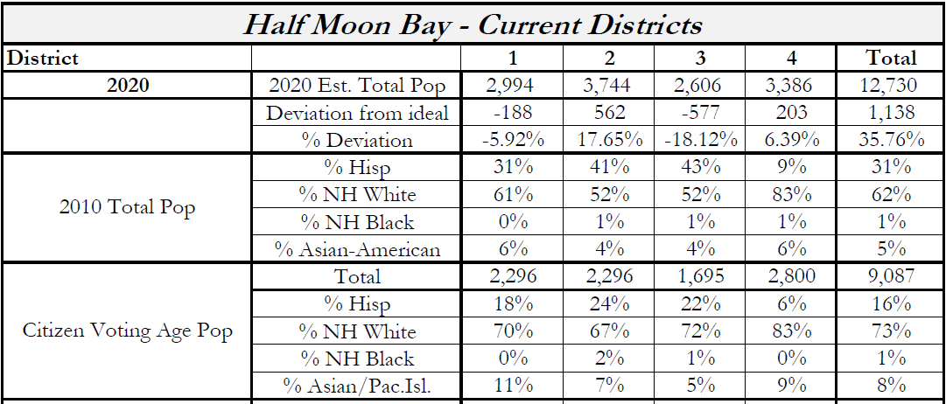
Demographic Summary of Existing Districts
Estimates using official 2020 demographic data and NDC’s estimated total population figures.
For four districts, each district must contain about 3,183 people.
For five districts, each district must contain about 2,546 people.

Slide 6
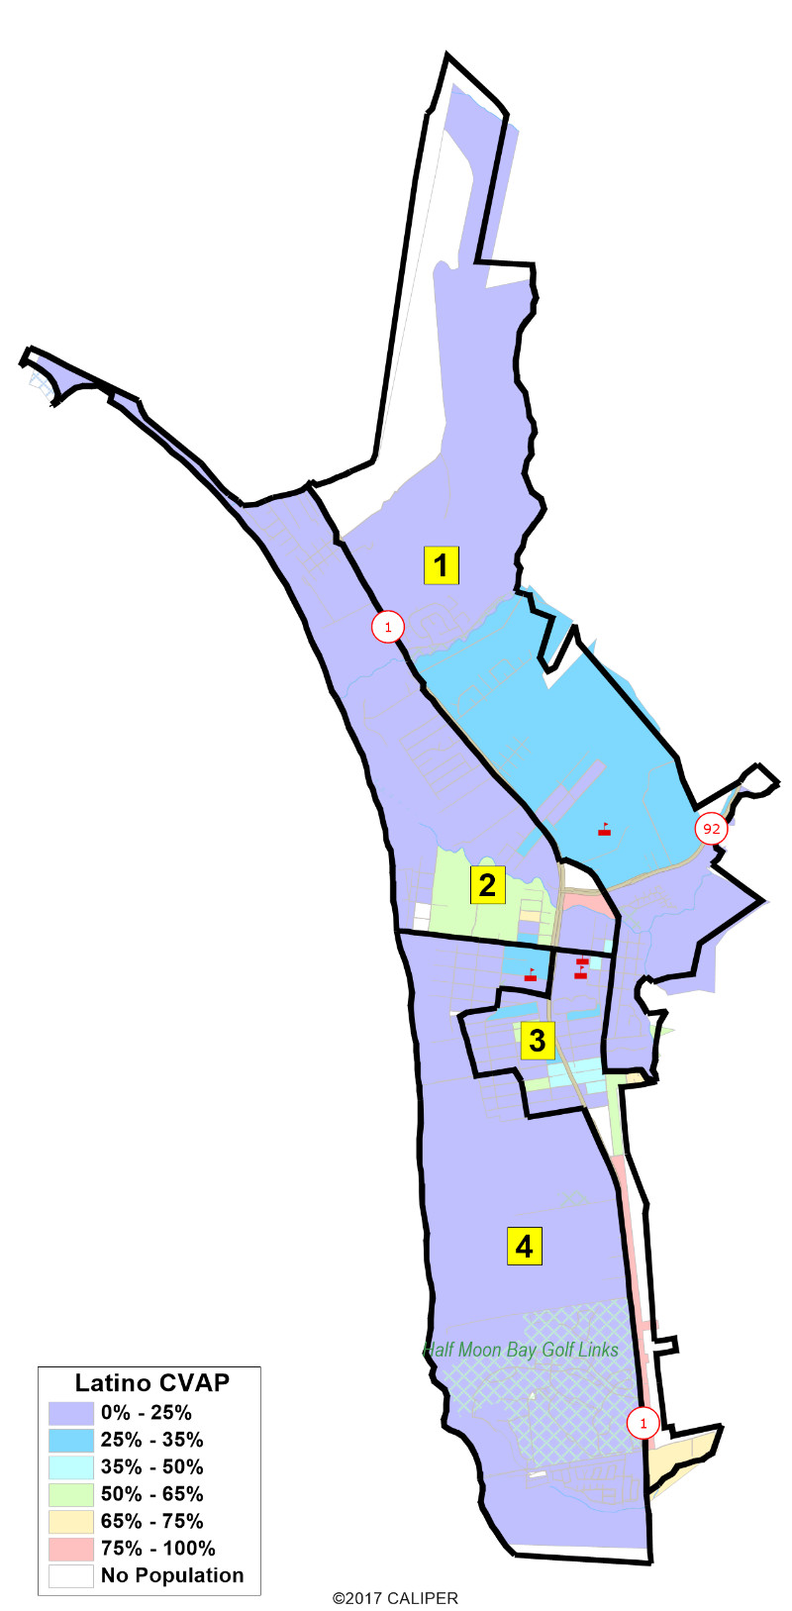
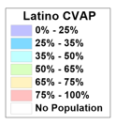
Latino CVAP
Latino eligible voters are concentrated in the southern portions of existing Districts 2 and 3.
Insert map

Slide 7
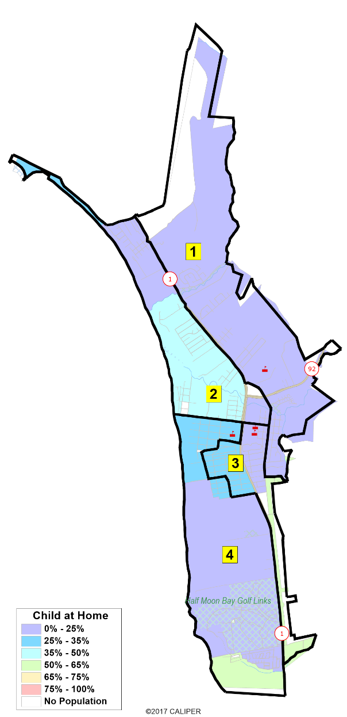
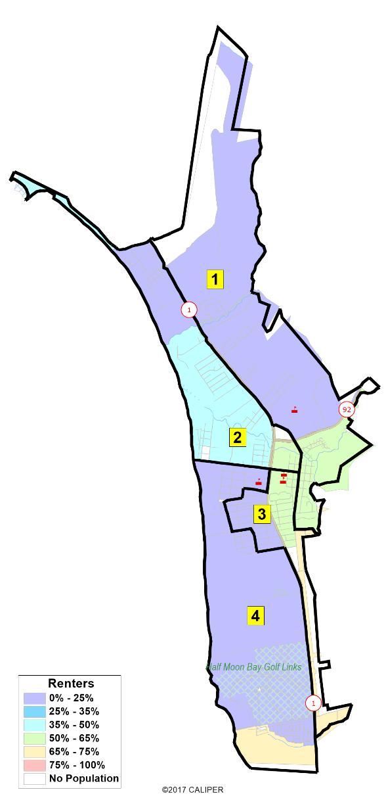
Other Socio-Economic Demographics
Households with at least one child at home.
Households that rent their homes.

Slide 8
Defining Neighborhoods
1st Question: What is your neighborhood?
2nd Question: What are its geographic boundaries?
Examples of physical features defining a neighborhood boundary:
Natural neighborhood dividing lines, such as highway or major roads, rivers, canals and/or hills
Areas around parks or schools
Other neighborhood landmarks
In the absence of public testimony, planning records and other similar documents may provide definition.

Slide 9
Beyond Neighborhoods: Defining Communities of Interest
1st Question: What defines your community?
Geographic Area, plus
Shared issue or characteristic
Shared social or economic interest
Impacted by city or county policies
Tell us “your community’s story”
2nd Question: Would this community benefit from being “included within a single district for purposes of its effective and fair representation”?
Or would it benefit more from having multiple representatives?
Definitions of Communities of Interest may not include relationships with political parties, incumbents, or political candidates.

Slide 10
Beyond Neighborhoods: Communities
Under the California Elections Code, “community of interest” has a very specific definition in the context of districting and redistricting cities and counties:
A “community of interest” is a population that shares common social or economic interests that should be included within a single district for purposes of its effective and fair representation.
Communities of interest do not include relationships with political parties, incumbents, or political candidates.
(emphasis added)

Slide 11
Model Options
Four Districts and Elective Mayor with 4-Year Term (current model)
Four Districts and Elective Mayor with 2-Year Term
Five Districts and Rotating Mayor

Slide 12
Public Mapping and Map Review Tools
Draw a Map
Different tools for different purposes and levels of technical interest
Interactive Review Map, a simple map review tool
Paper “Public Participation Kit,” for those who do not want to use a computer
Paper- and Excel-based simple “draw a draft map” tools
DistrictR, an easy-to-use paint brush map drawing tool
Caliper Maptitude Online Redistricting, a powerful, data-rich “draw a draft map” online mapping tool
For four districts, each district must contain about 3,183 people.
For five districts, each district must contain about 2,546 people.

Slide 13
All Submitted Maps are Professionally Produced by NDC for Public Review

Slide 14
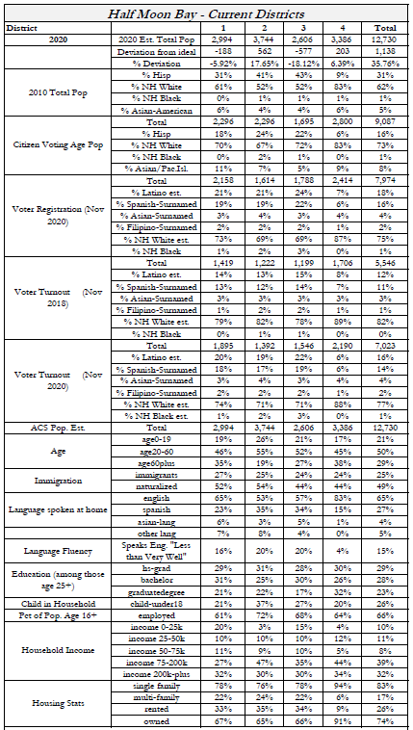
A Demographic Summary is Prepared by NDC for All Submitted Maps

Slide 15
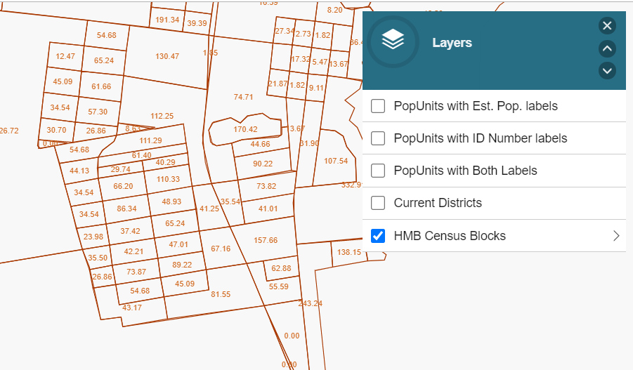
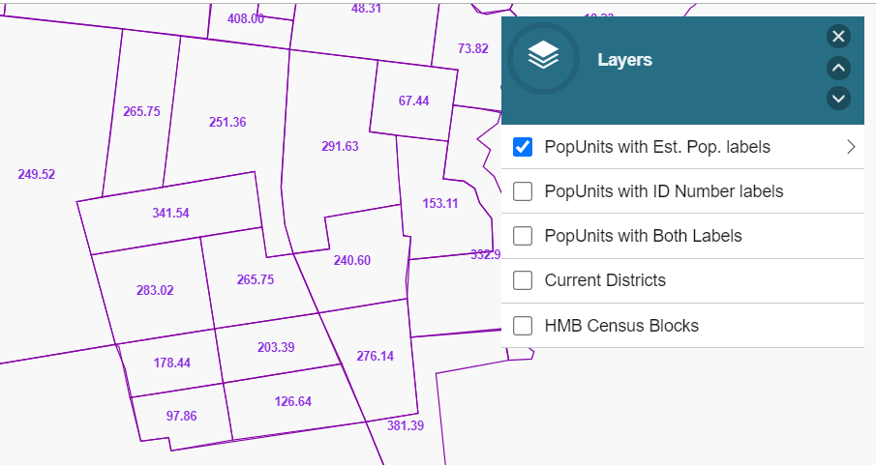
Census Blocks
NDC Population Units
Interactive Review Map

Slide 16
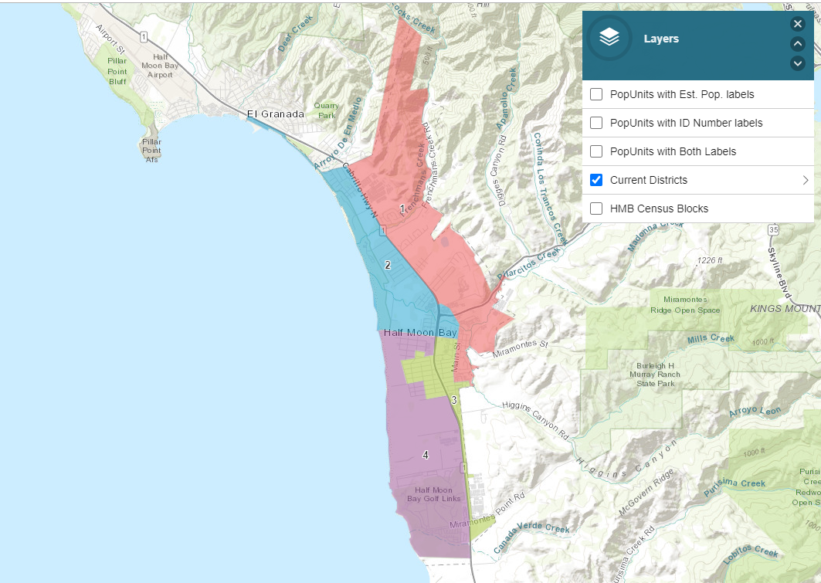
Simple Map Review Tool
Online Interactive Review Map
ESRI’s “ArcGIS Online” – similar to Google Maps in ease of use
Used to review, analyze and compare maps, not to create them
Includes overlays of “community of interest” and other data

Slide 17
Simple Map Drawing Tool
Paper “Public Participation Kit”
For those without internet access or who prefer paper
Total Population Counts only – no demographic numbers

Slide 18
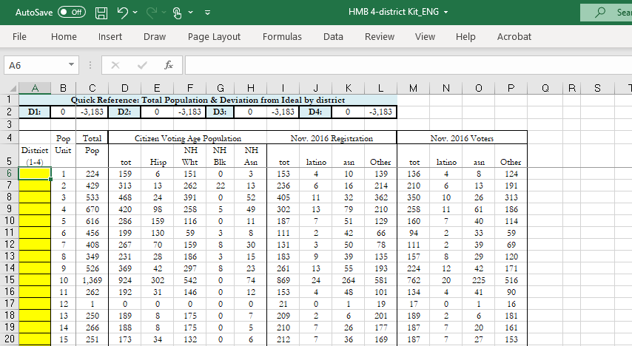
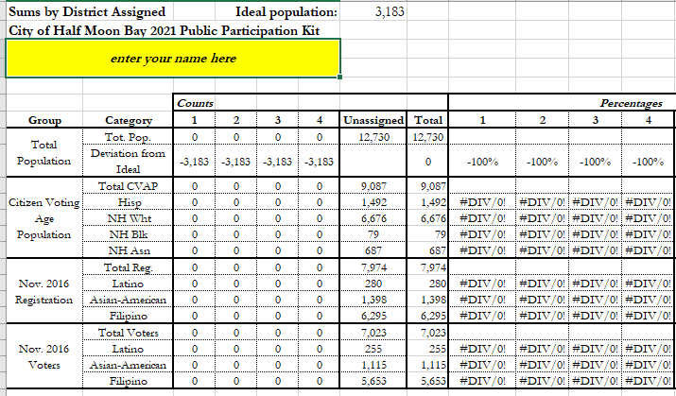
Simple Map Drawing Tool + Excel Supplement
“Public Participation Kit” with Population Unit ID#s
For those who know Excel and do not wish to use online tools
Adds CVAP data
Excel does the math

Slide 19
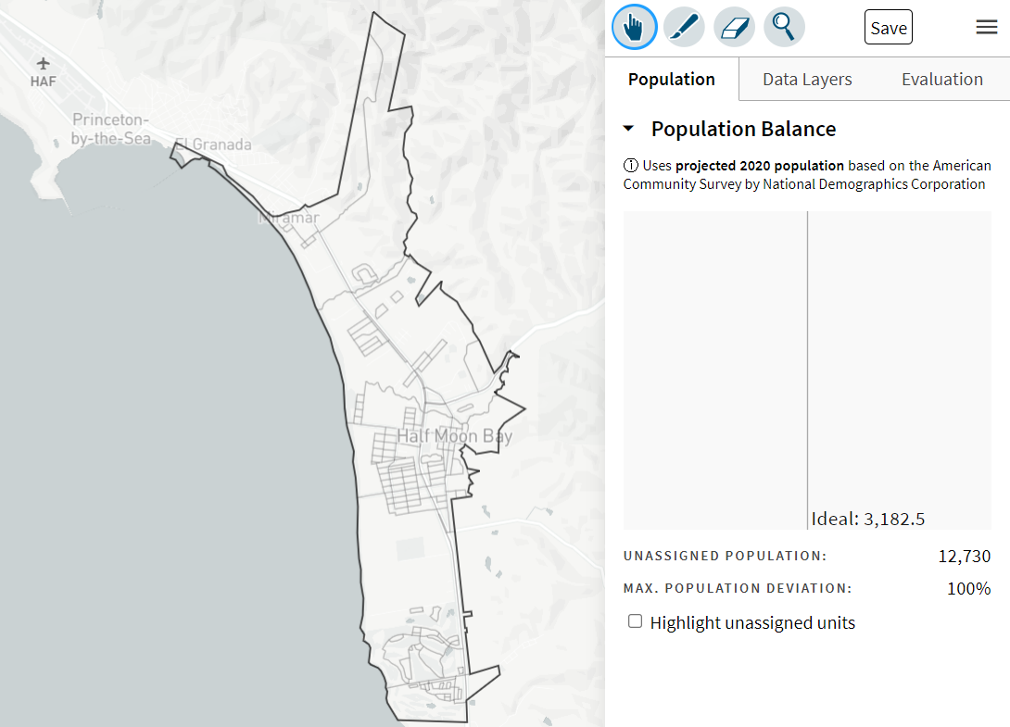
DistrictR
DistrictR, an easy-to-use paint brush map drawing tool
Use to draw your neighborhood, a community of interest or an entire district map.
Similar external options: Representable.org, DrawMyCACommunity.org

Slide 20
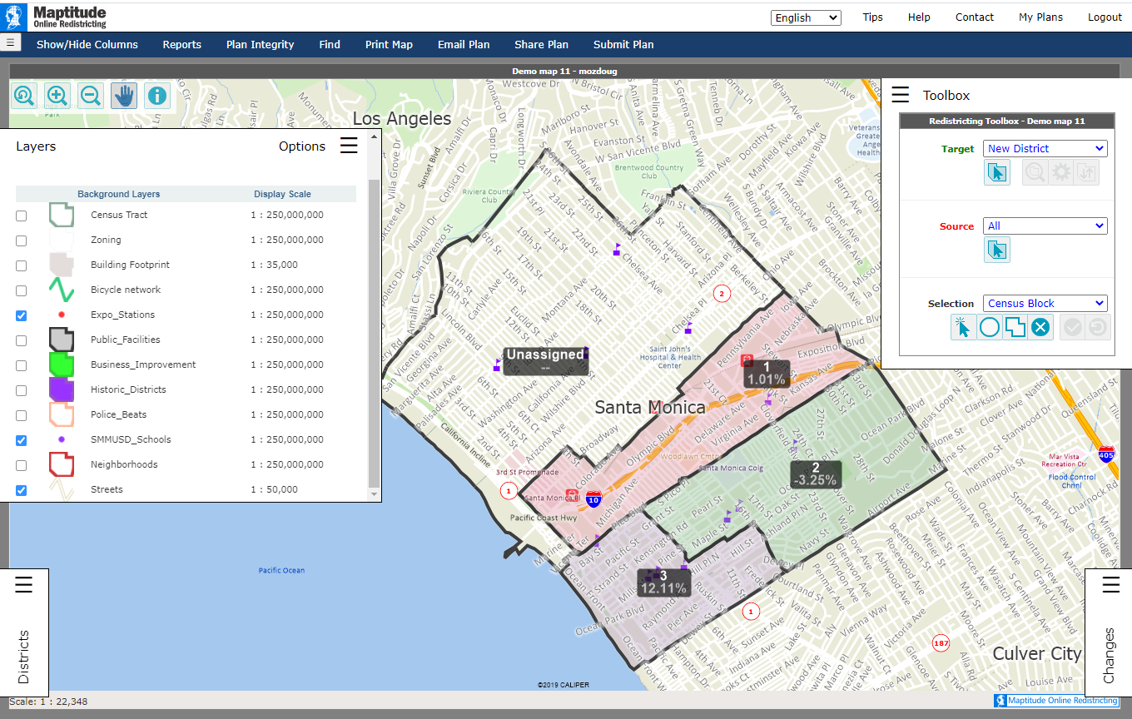
Caliper’s “Maptitude Online Redistricting”
Full Database, Powerful Online Mapping Tool
Powerful, common, data-rich online tool
Six language options: English, Spanish, Portuguese, Vietnamese, Mandarin and Korean
Quick Start Guide

Slide 21
Public Hearing & Discussion
What is your neighborhood and what are its boundaries?
What other notable areas are in the City, and what are their boundaries?
Any questions about the mapping tools?
ACTION
Action to identify areas that meet each FAIR MAPS Act (AB 849) definition:
“neighborhoods”
“communities of interest . . . that should be included within a single district for purposes of its effective and fair representation.”

Slide 22
DrawHMB.org

