Slide 1
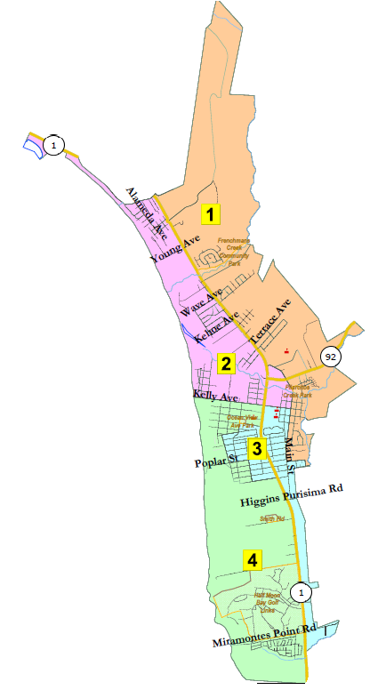
City of Half Moon Bay
Redistricting Draft Maps
Redistricting Advisory Committee
Marin Holt, Chair
Paul Gater, Vice Chair
Hal Bogner, Committee Member
Steve Maller, Committee Member
Claudia Marshall, Committee Member
Phil Marshall, Committee Member
Michal Settles, Committee Member
National Demographics Corporation

Slide 2
Step | Description
Workshops (RAC) Aug. 12 & Aug. 19 | Education and to solicit input on the communities in the Districts.
Two Pre-Map Hearings (RAC) Aug. 26 & Sept. 2 | Held prior to release of draft maps. Education and to solicit input on the communities in the Districts.
Census Data Release Aug. 12 | Census Bureau releases official 2020 Census population data. The data will be in legacy format and must be reformatted.
California Data Release Sept. 20 | California Statewide Database releases ‘prisoner-adjusted’ 2020 redistricting data, then three-week waiting period to release maps.
Review Draft Maps (RAC) Nov. 8 | Review and revise the draft maps and to select focus maps.
Map Submission Deadline Nov. 26, 5 p.m. | The City’s demographer will professionally produce submitted maps and prepare a demographic summary for each map.
Review Draft Maps (RAC) Dec. 16 | Review and revise the draft maps and to select focus maps.
Post-Map Hearing (CC) Jan. 19 | First public hearing to discuss and revise the draft maps and to discuss the election sequence.
Workshops (RAC) Jan. 22 & Jan. 27 | Solicit input on focus maps.
Post-Map Hearing (CC) Feb. 15 | Second public hearing to discuss and revise the draft maps and to discuss the election sequence.
Map Adoption (CC) Mar. 15 | Final map must be posted at least 7 days prior to adoption. Map adopted via ordinance. Deadline to adopt: Apr. 17, 2021

Slide 3
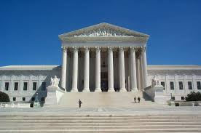
Redistricting Rules and Goals
1. Federal Laws
2. California Criteria for
Cities
3. Other Traditional Redistricting Principles
Equal Population
Federal Voting Rights Act
No Racial Gerrymandering
Geographically contiguous
Undivided neighborhoods and “communities of interest”
(Socio-economic geographic areas that should be kept together)
Easily identifiable boundaries
Compact
(Do not bypass one group of people to get to a more distant group of people)
Prohibited: “Shall not favor or discriminate against a political party.”
Minimize voters shifted to different election years
Respect voters’ choices / continuity in office
Future population growth
Preserving the core of existing districts

Slide 4
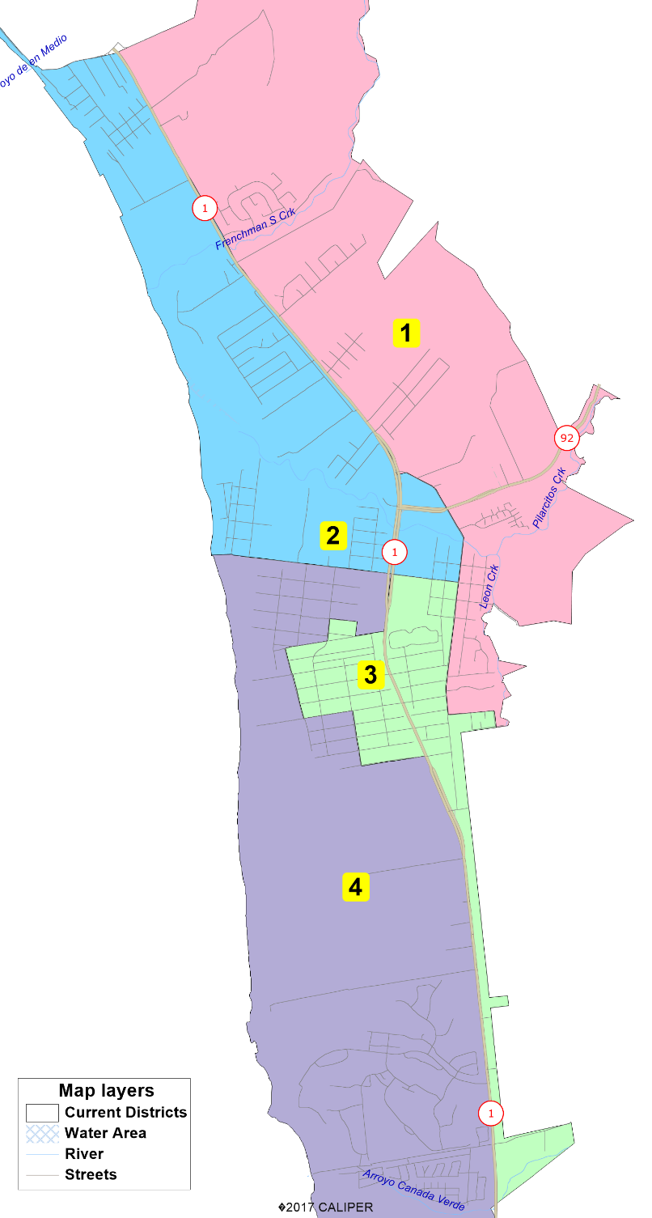
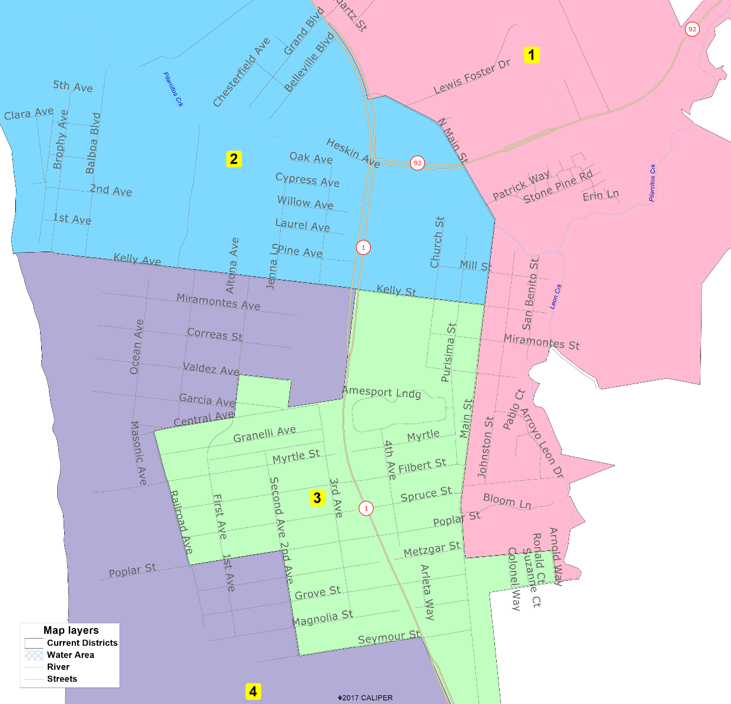
Current Districts

Slide 5
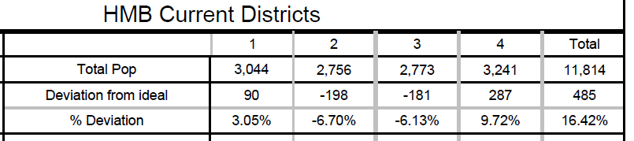
Demographic Summary of Existing Districts
Official California-Adjusted 2021 Redistricting Data
Only required change is about 200 people out of District 4 into Districts 2 and 3.
Notes:
2020 Legacy: 11,795
11,795 5 2,359
11,795 4 2,949

Slide 6
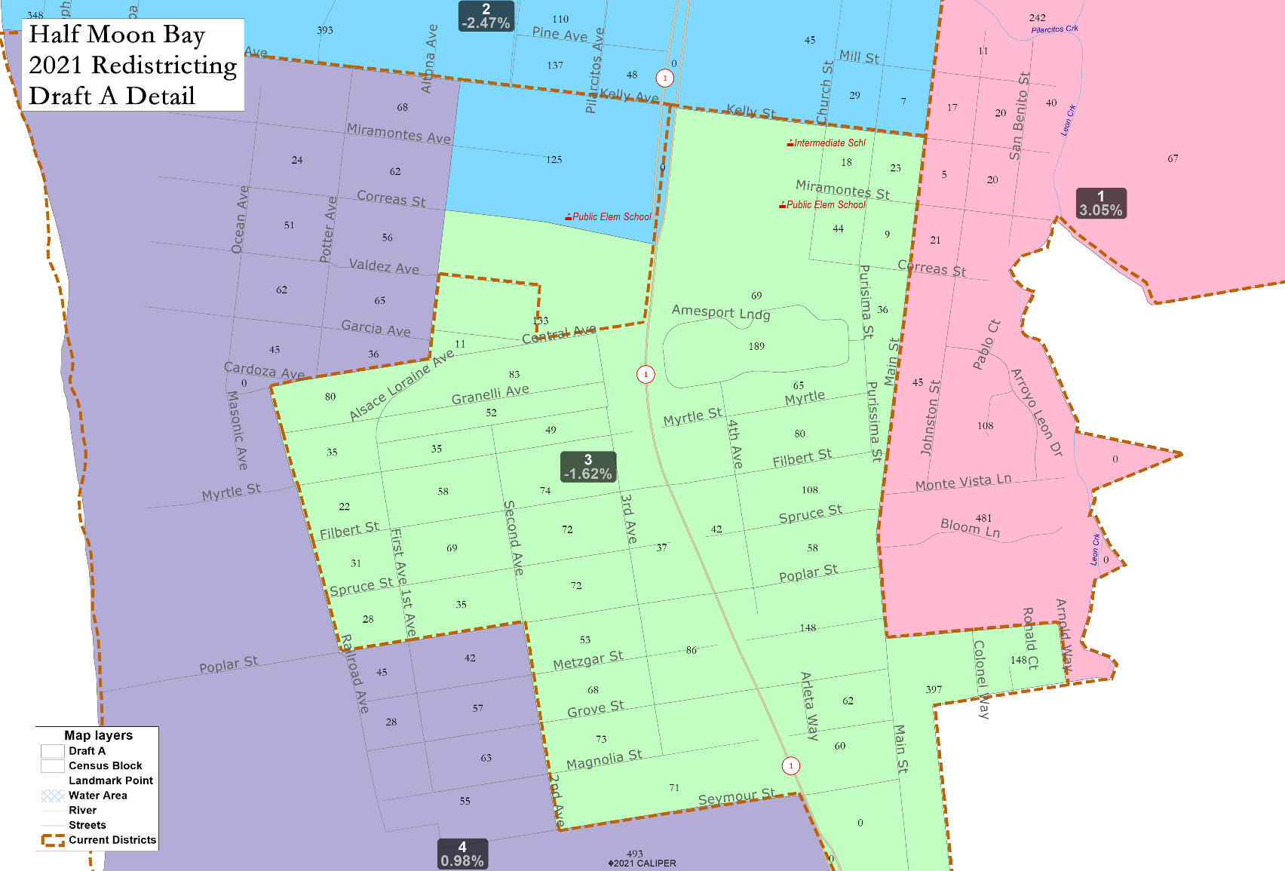
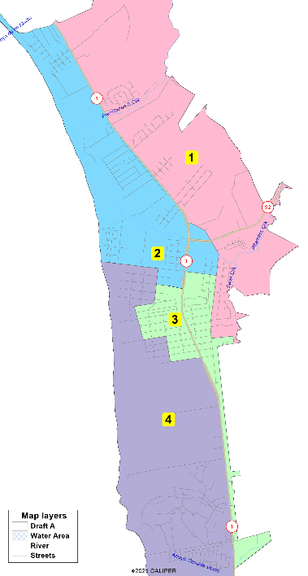
NDC 4-District Draft A
1. Census Bureau merged two Census Blocks across the Council District line. Draft A puts the Block all in D3.
2. Census Block bordered by Kelly Ave, Hwy 1, Correas St and Alsace Lorraine Ave moves from D4 to D2.
Highway 1 is the border north and south of what is shown here.
Those changes population balance the entire map.

Slide 7
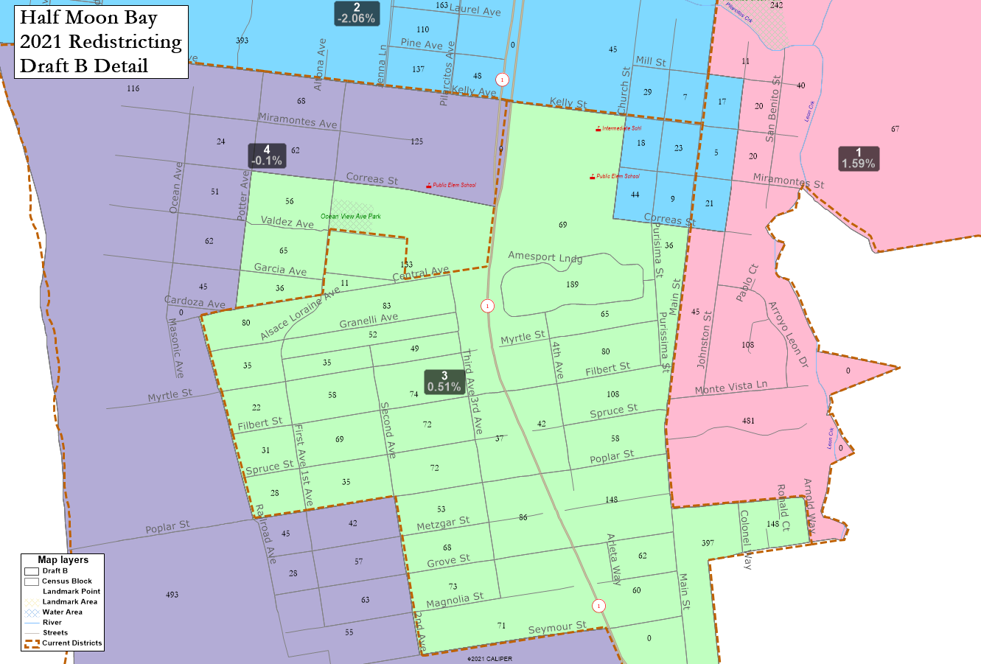

NDC 4-District Draft B
1. Census Bureau merged two Census Blocks across the Council District line. Draft B puts the Block all in D3, along with three city blocks south of Correas between Potter and Alsace Lorraine.
2. D2 picks up 7 city blocks around Kelly & Main St from D1 and D3
Highway 1 is the border north and south of what is shown here.
These changes population balance the entire map.

Slide 8
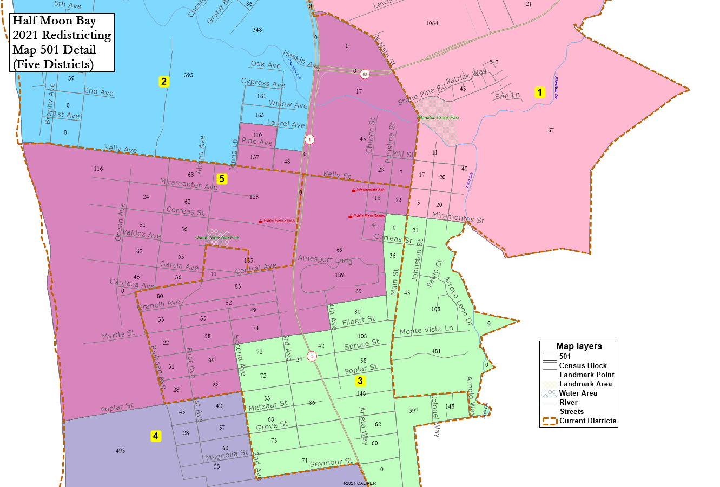
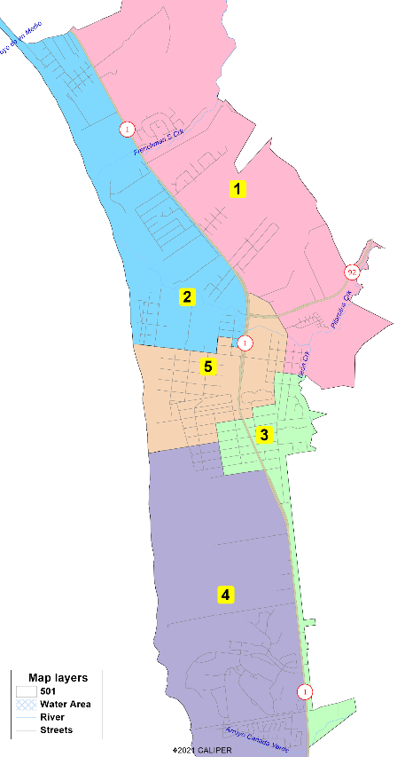
NDC 5-District Alternative 501
Highway 1 is the border north and south of what is shown here.
Total population per district drops from 2,954 with four districts to 2,363 with five districts.

Slide 9
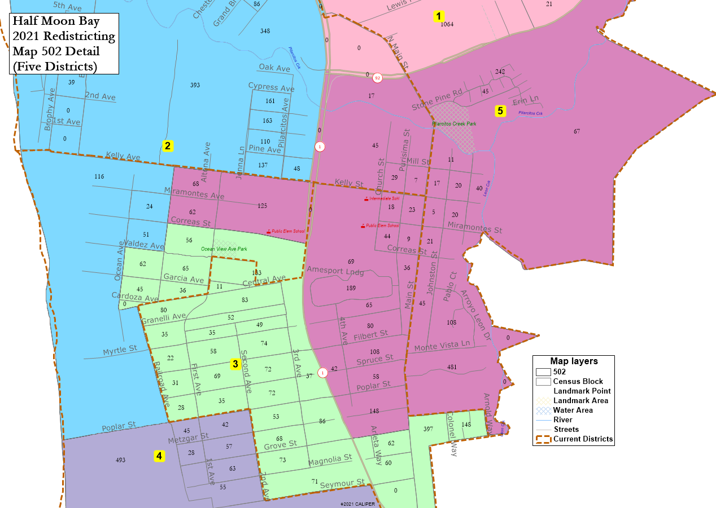
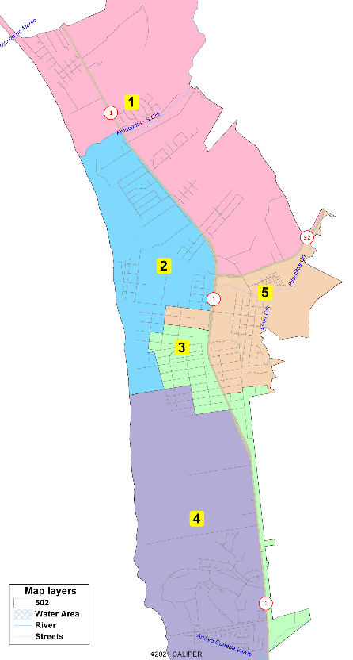
NDC 5-District Alternative 502
Highway 1 is the border south of what is shown here.
Everything north of Frenchman Creek is in District 1.

Slide 10
Demographic Impact
City is a whole is 16% Latino and 73% White (by Citizen Voting Age Population, or CVAP)
Non-White CVAP is not concentrated in any one area
In a four-district map, the districts range from 21% to 24% Latino and 66% to 81% White by CVAP
In a five-district map, the districts range from 23% to 28% Latino and 63% to 81% White by CVAP
Total population per district drops from 2,954 with four districts to 2,363 with five districts.

Slide 11
Current Districts

Slide 12

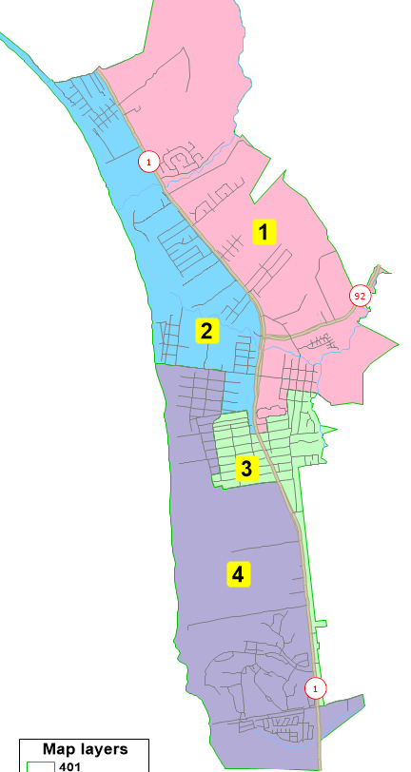
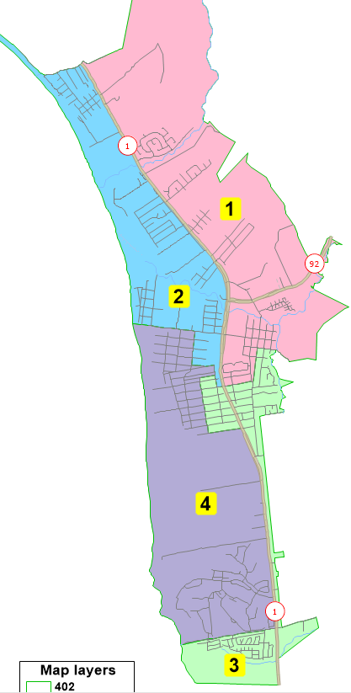
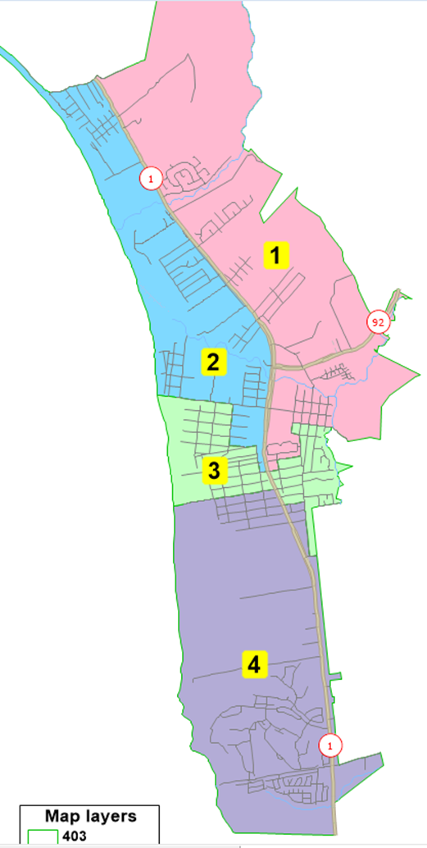
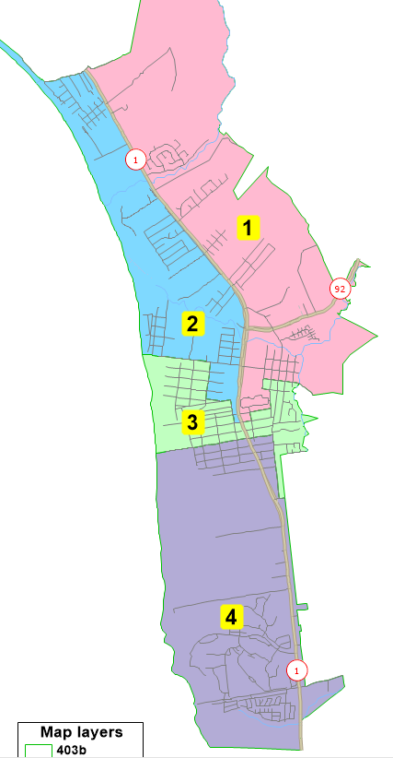
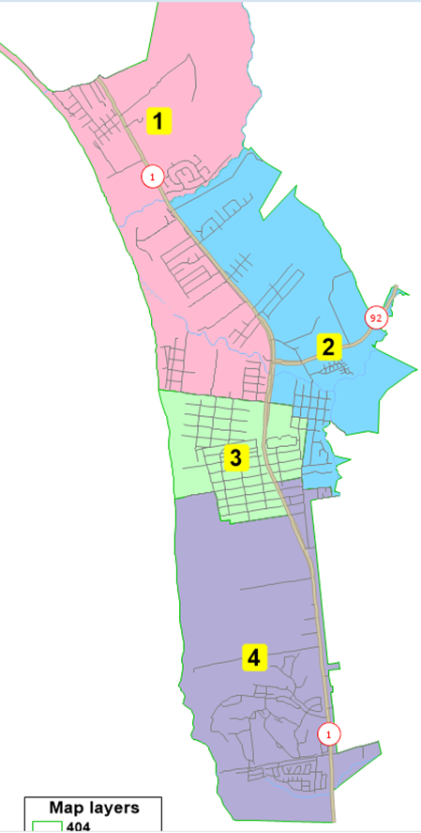
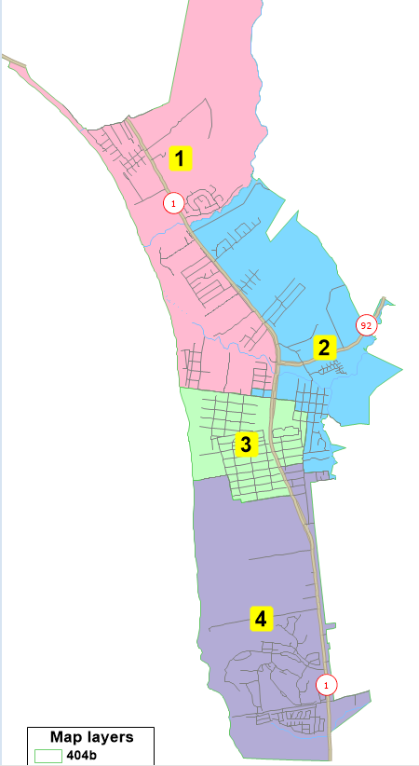
Not Population Balanced
Current Districts
NDC 4-District Draft A
NDC 4-District Draft B
Map 401
Map 402
Not Population Balanced
Not Population Balanced
4-District
Plans
Map 403
Map 403b
Map 404
Map 404b

Slide 13



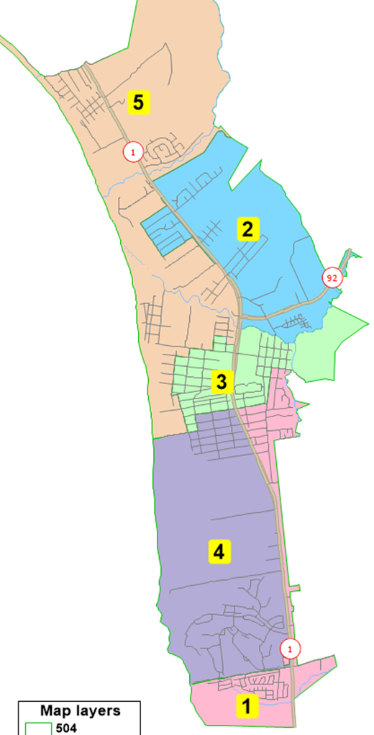
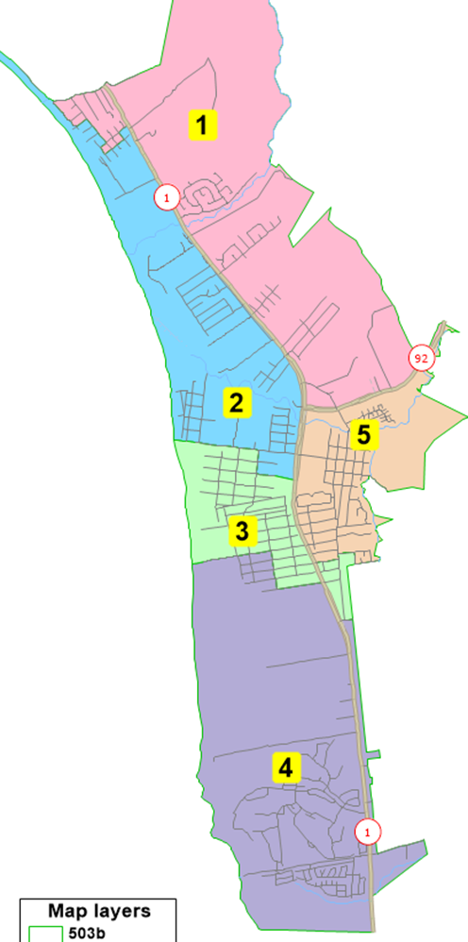


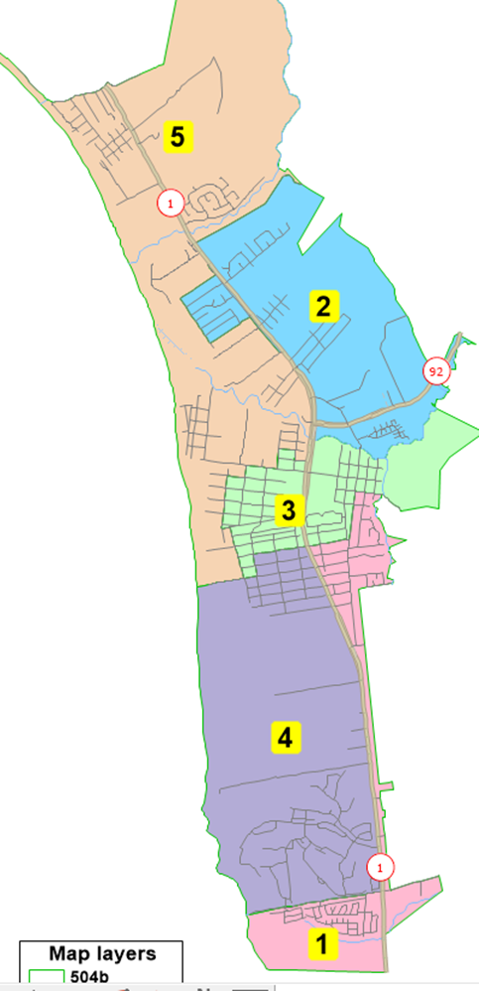

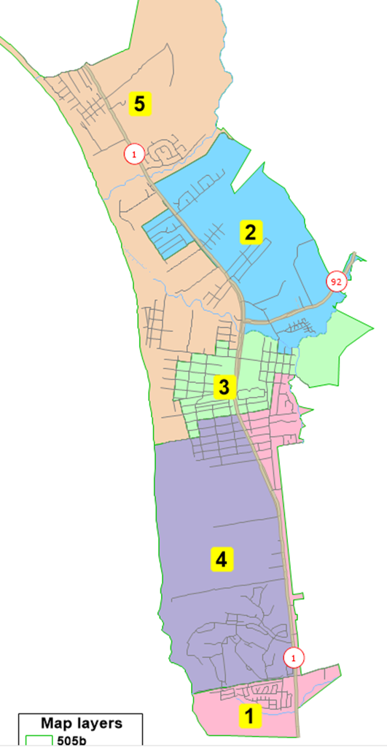
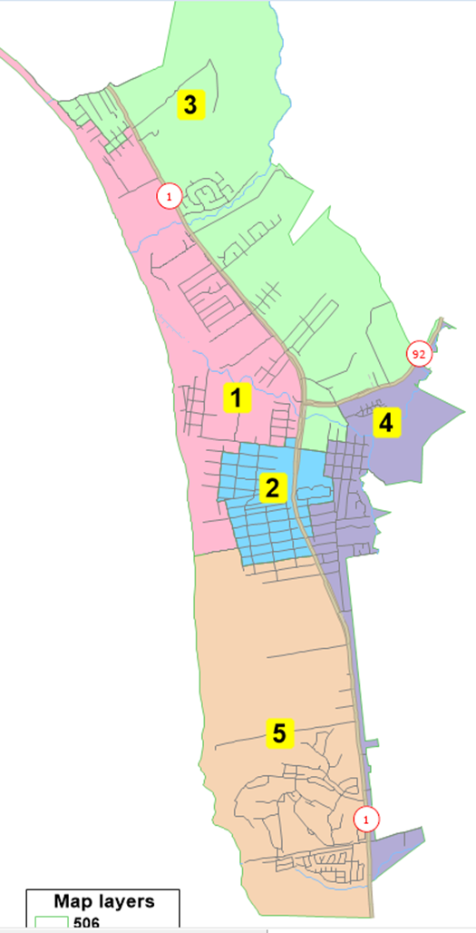
NDC 5-District Alternative 501
NDC 5-District Alternative 502
Map 503
Map 503b
Map 504
5-District
Plans
Map 504b
Map 505
Map 505b
Map 506

Slide 14
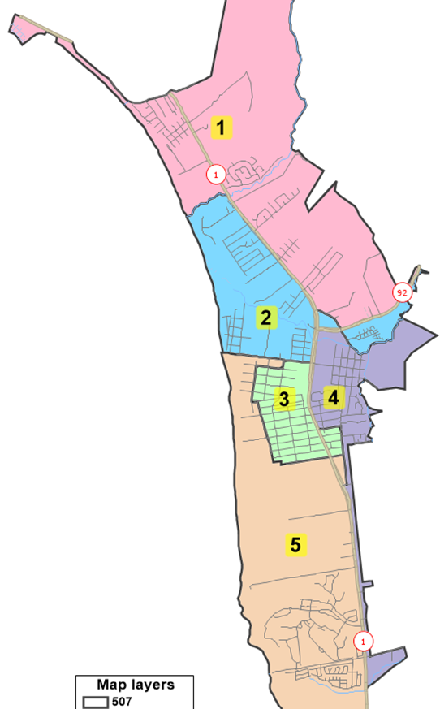
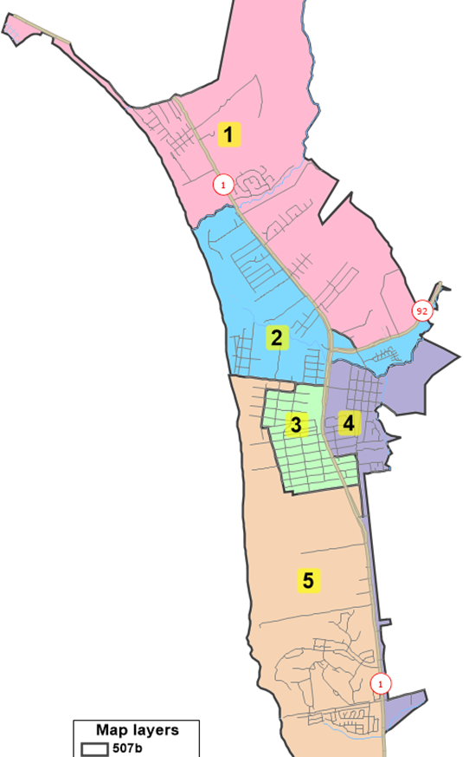
Map 507
Map 507b
Non-Contiguous (at Main & Hwy 92)
More
5-District
Plans

Slide 15
NDC 4-District Draft A

Slide 16
NDC 4-District Draft B

Slide 17
NDC 5-District Alternative 501

Slide 18
NDC 5-District Alternative 502

Slide 19
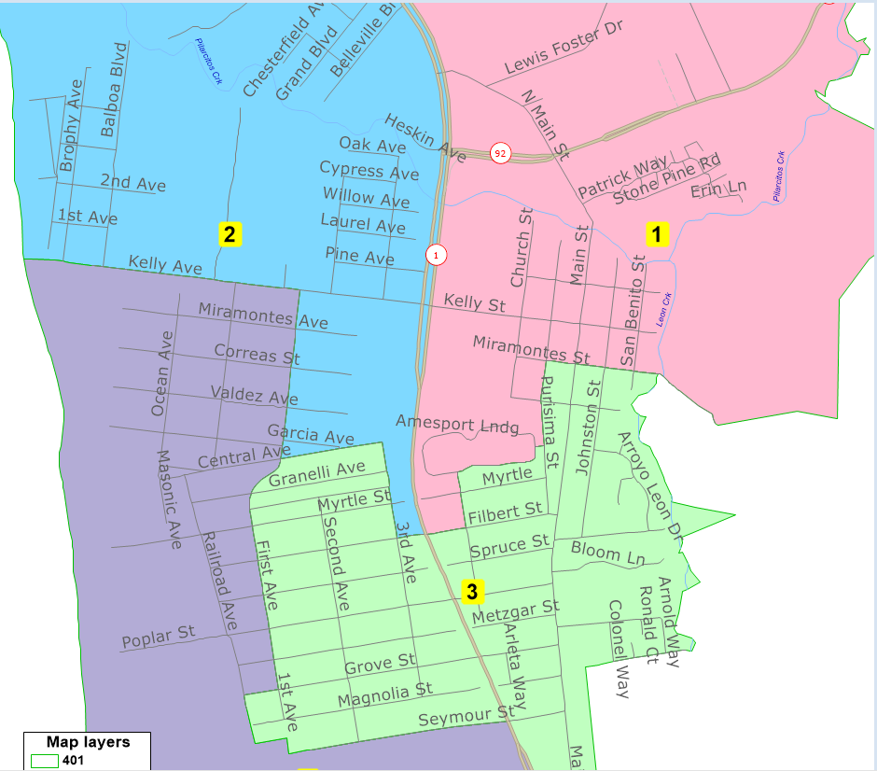
Map 401

Slide 20
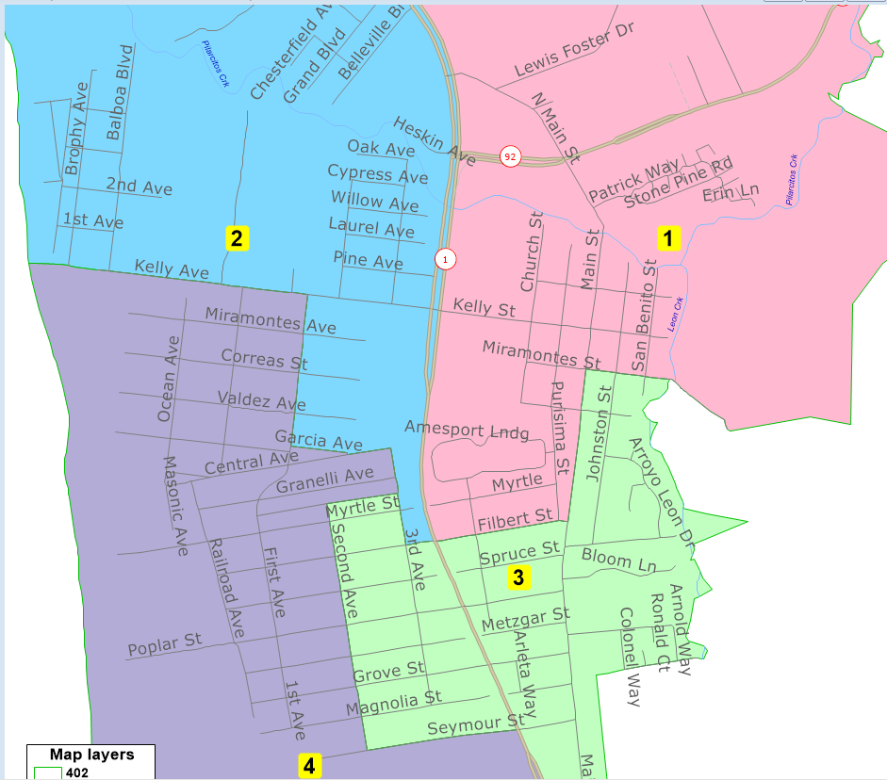
Map 402

Slide 21

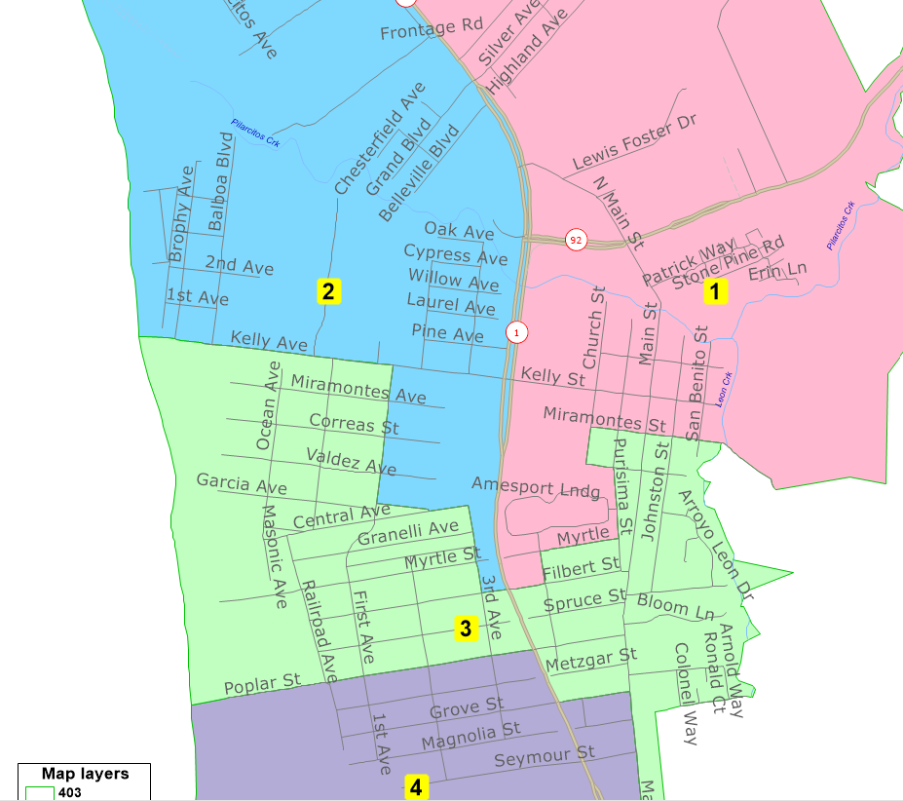
Map 403
Not Population Balanced

Slide 22
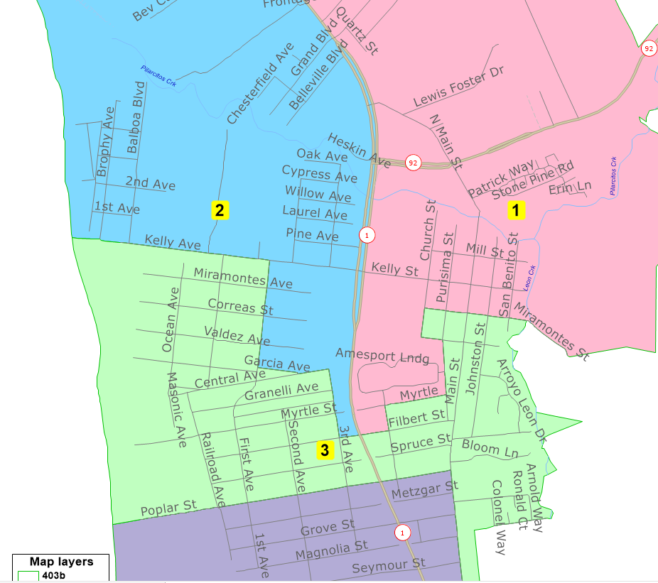
Map 403b

Slide 23

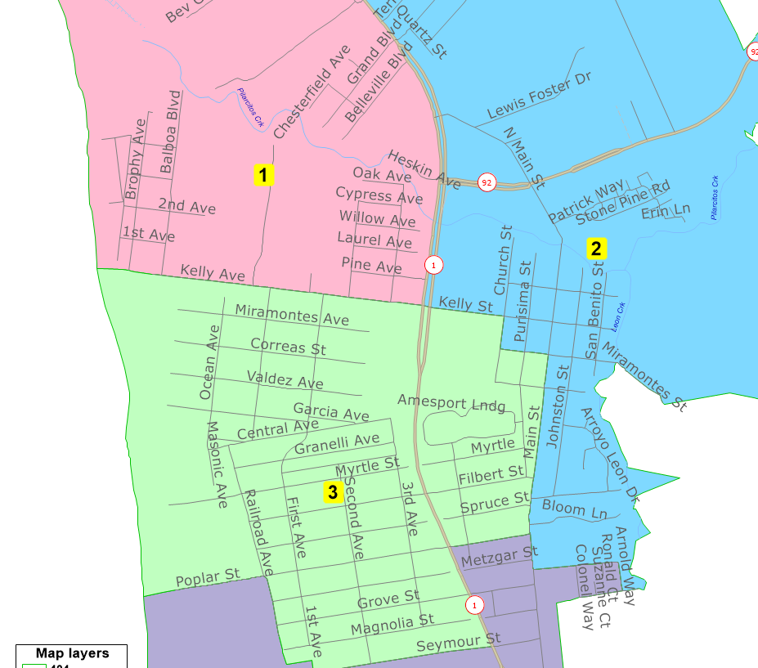
Map 404
Not Population Balanced

Slide 24
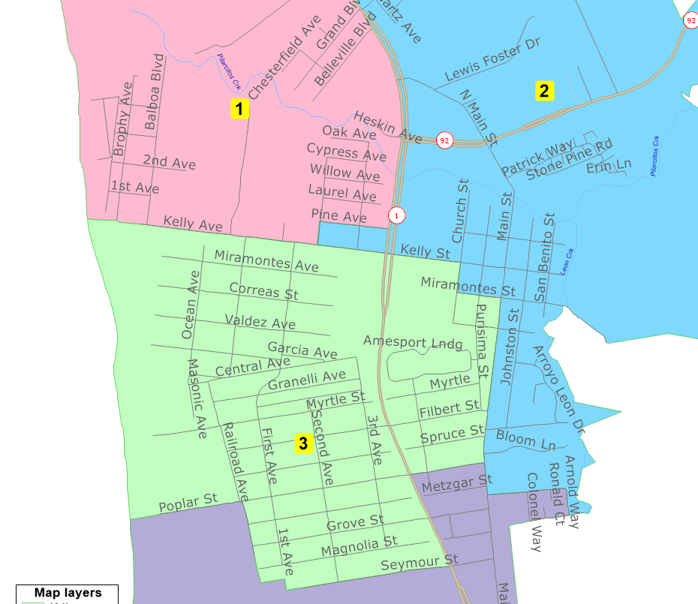
Map 404b

Slide 25

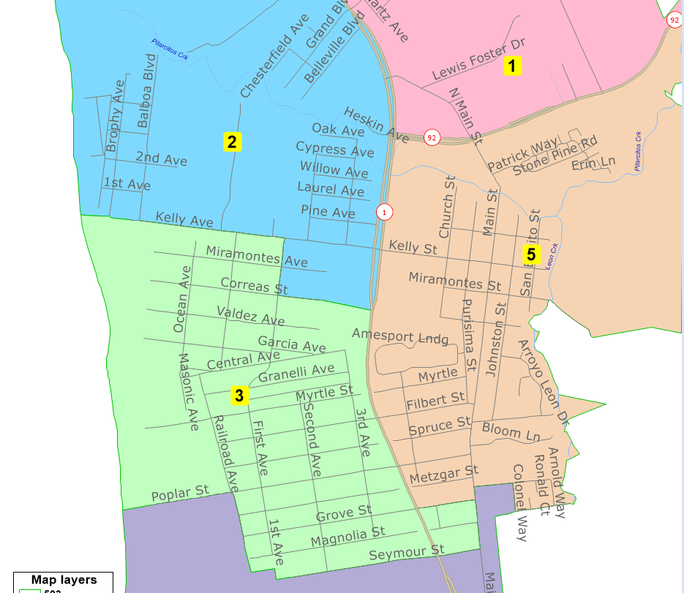
Map 503
Not Population Balanced

Slide 26

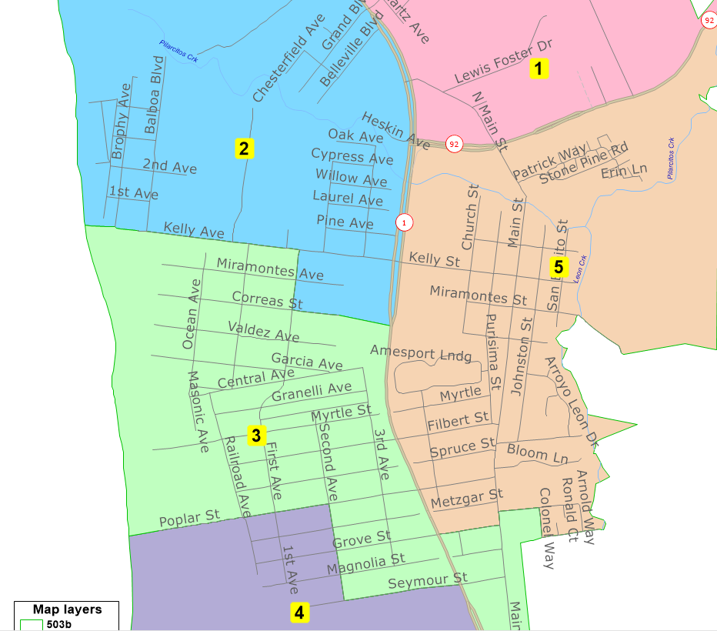
Map 503b

Slide 27

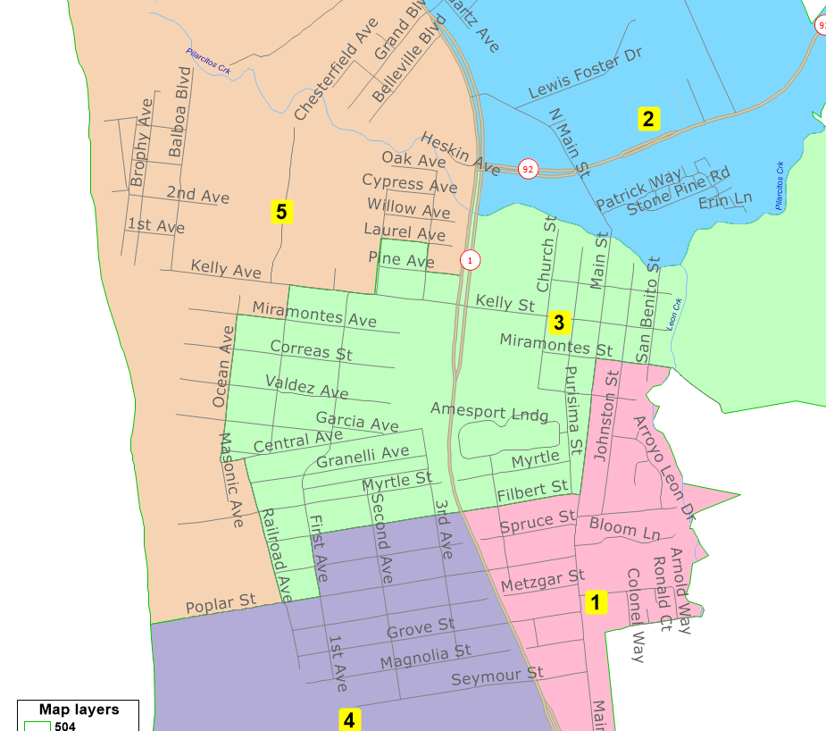
Map 504
Non-Contiguous (at Troon Way)

Slide 28

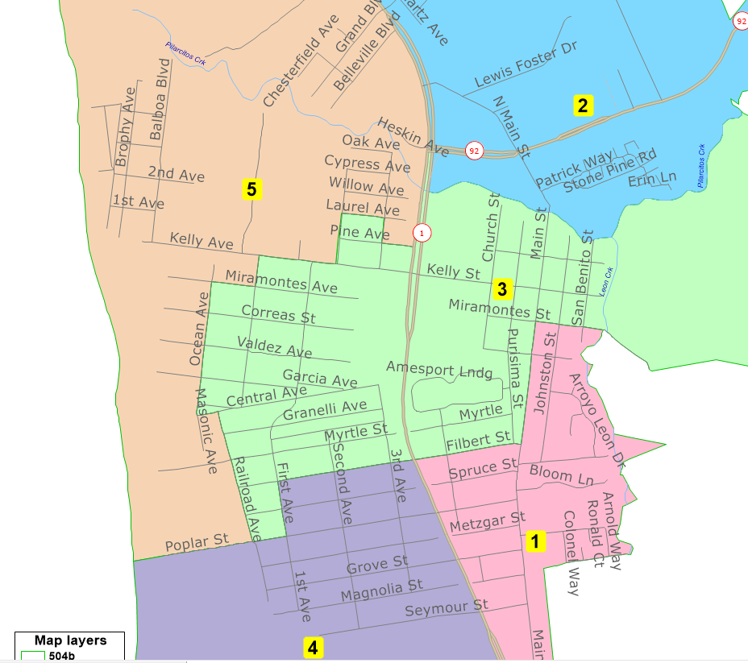
Map 504b

Slide 29

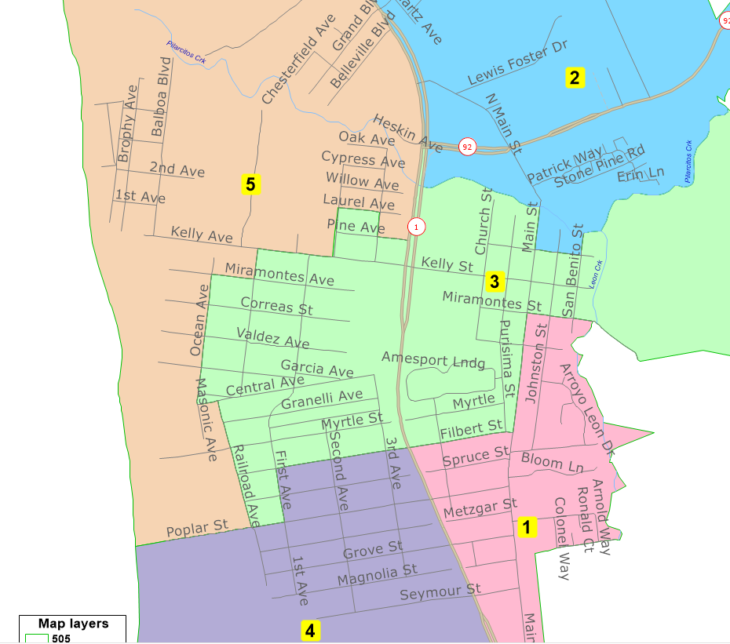
Map 505
Non-Contiguous (at Troon Way)

Slide 30

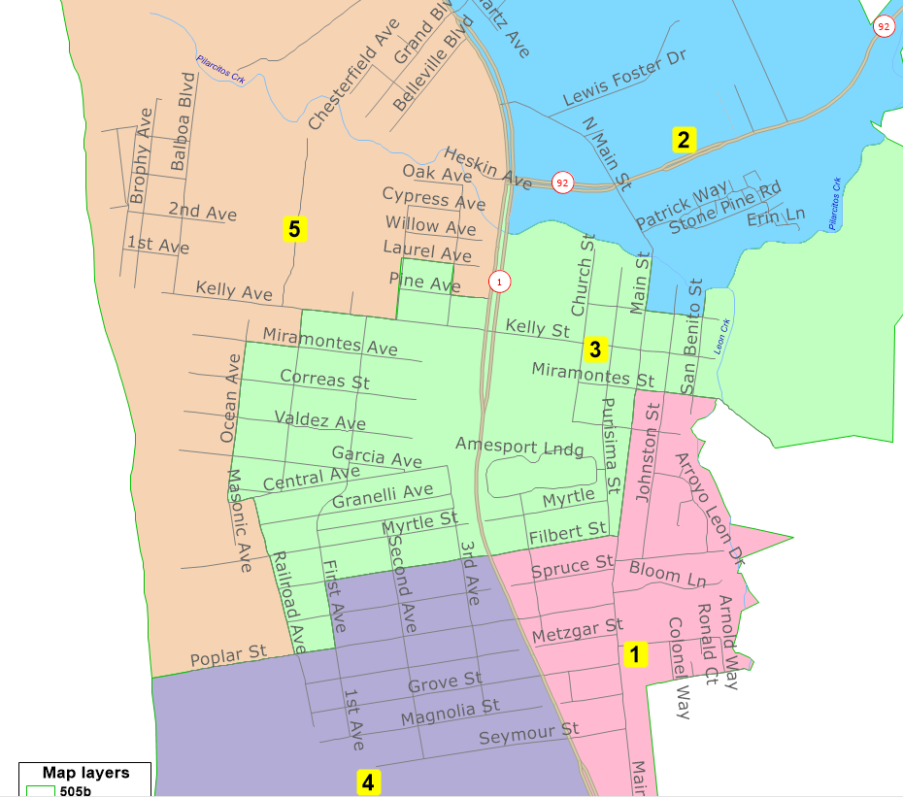
Map 505b

Slide 31

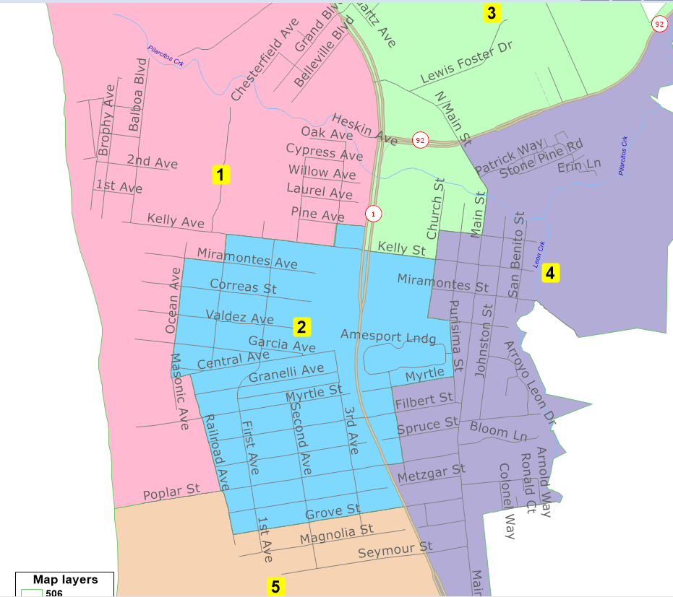
Map 506

Slide 32

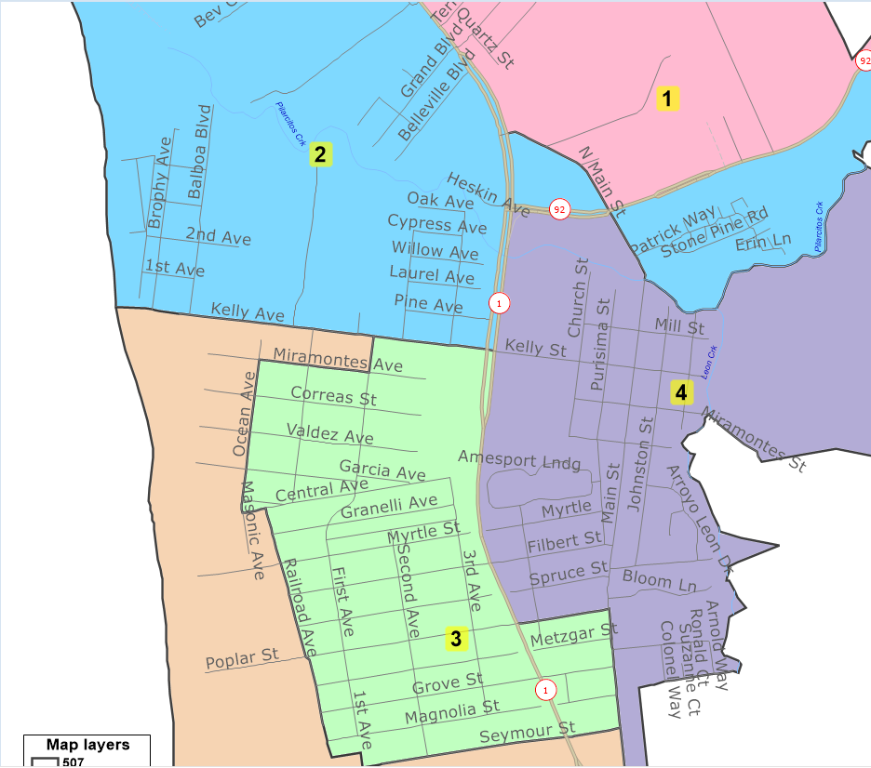
Map 507
Non-Contiguous (at Main & Hwy 92)

Slide 33
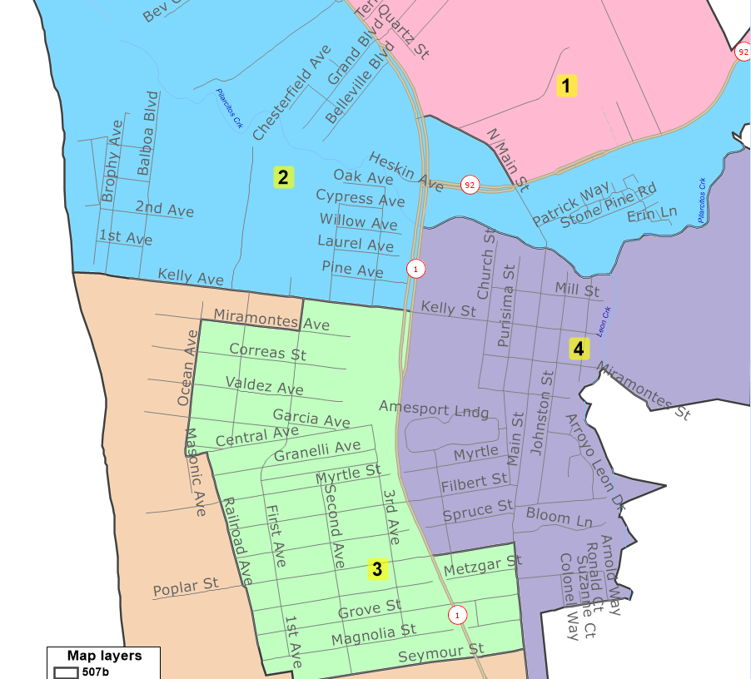

Map 507b

Slide 34
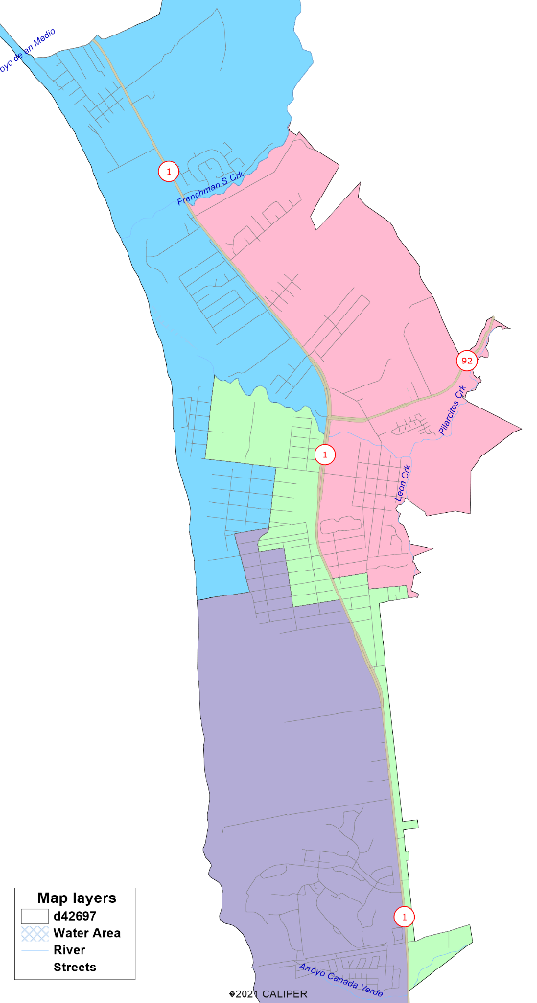
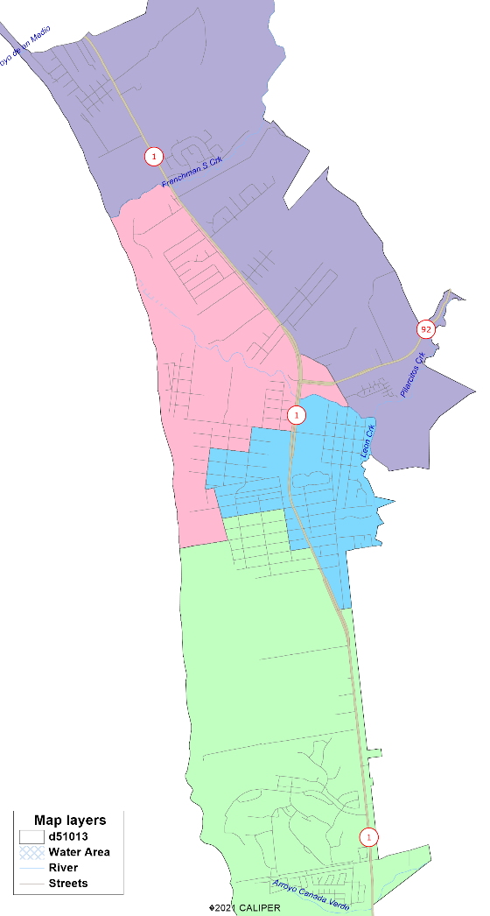
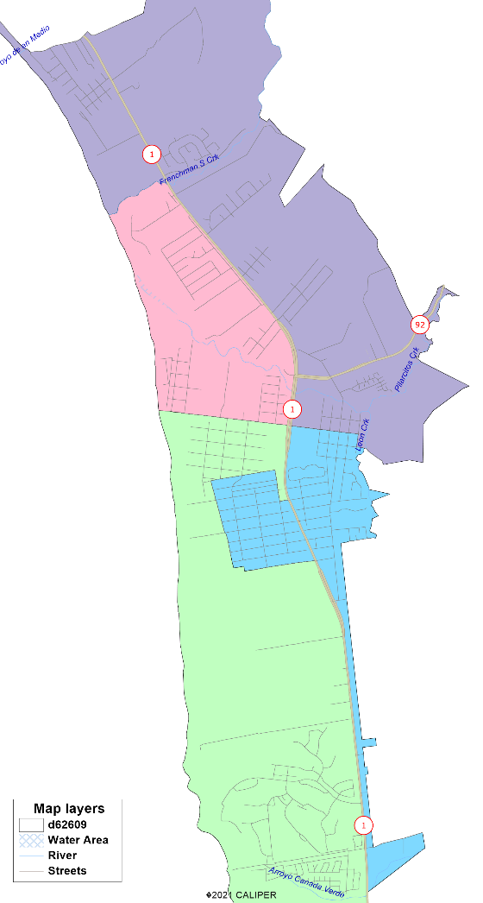
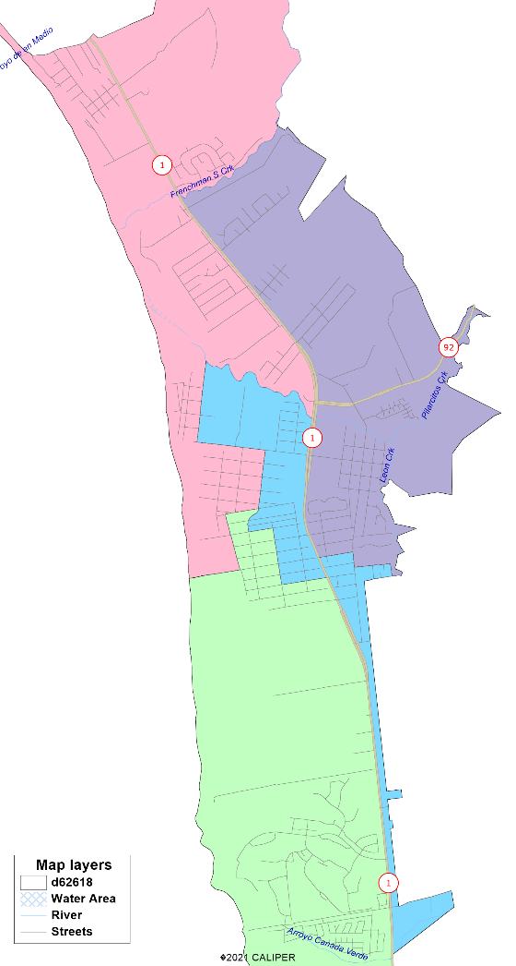
4-District Submissions
Not Population Balanced
Unfortunately, the Census results were so significantly different from expectations that none of the public map submissions are even close to population balanced.

Slide 35

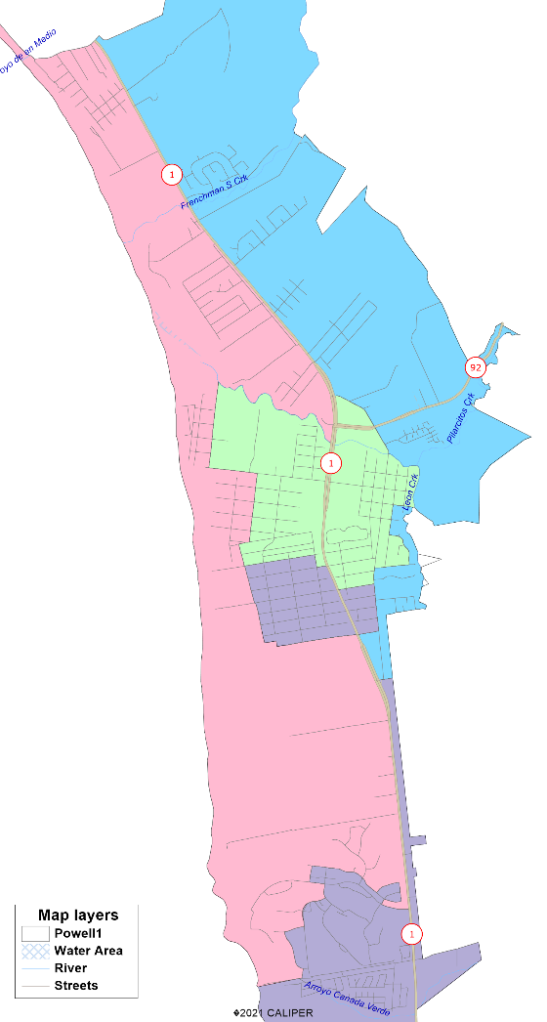
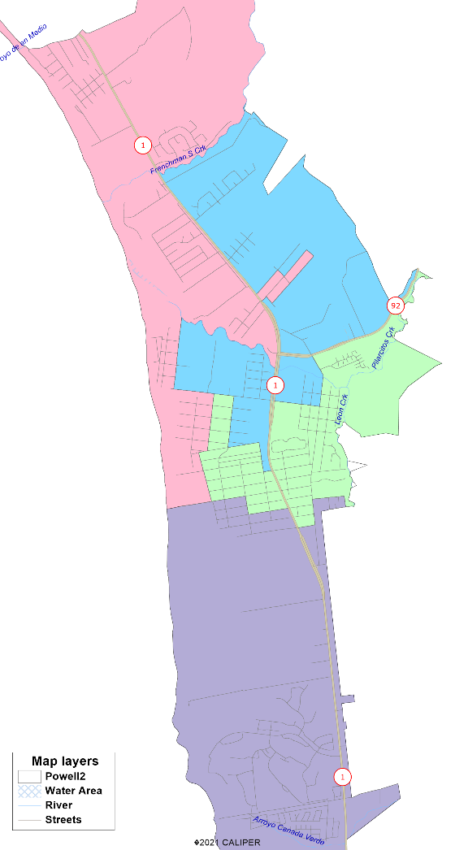
More 4-District Submissions
Not Population Balanced
Unfortunately, the Census results were so significantly different from expectations that none of the public map submissions are even close to population balanced.

Slide 36
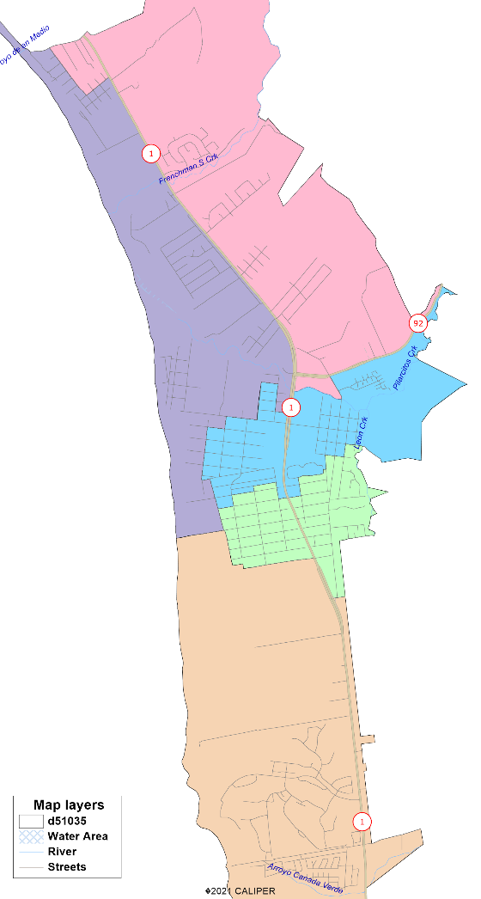
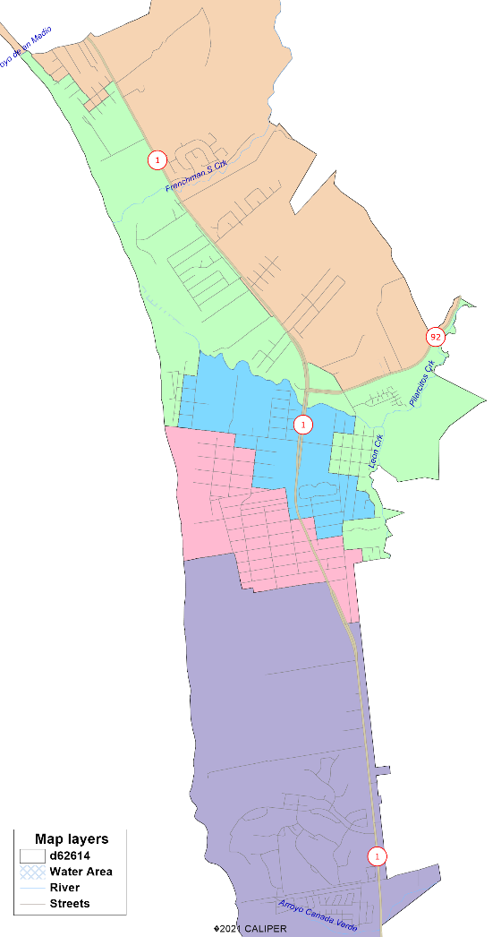
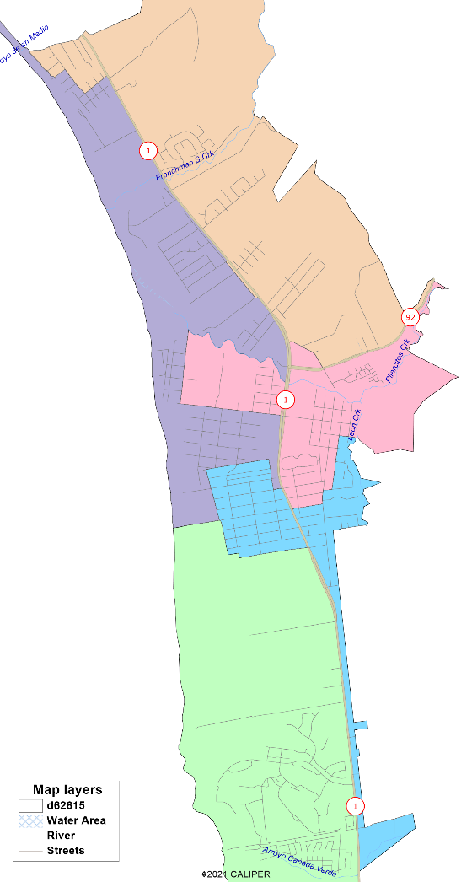

5-District Submissions
Not Population Balanced
Unfortunately, the Census results were so significantly different from expectations that none of the public map submissions are even close to population balanced.

Slide 37
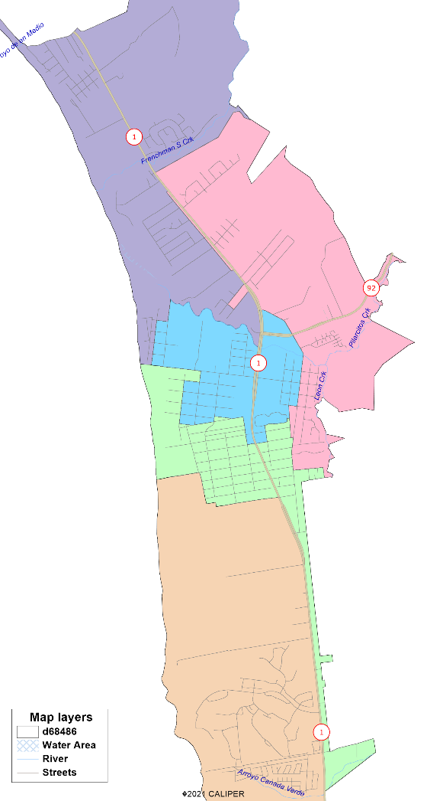



More 5-District Submissions
Not Population Balanced
Unfortunately, the Census results were so significantly different from expectations that none of the public map submissions are even close to population balanced.

Slide 38




Demographics 4-District Plans

Slide 39
Demographics 5-District Plans

Slide 40
More Demographics 5-District Plans

Slide 41
Map Notes 4-District Plans

Slide 42
Map Notes 5-District Plans

Slide 43

DrawHMB.org

