Slide 1
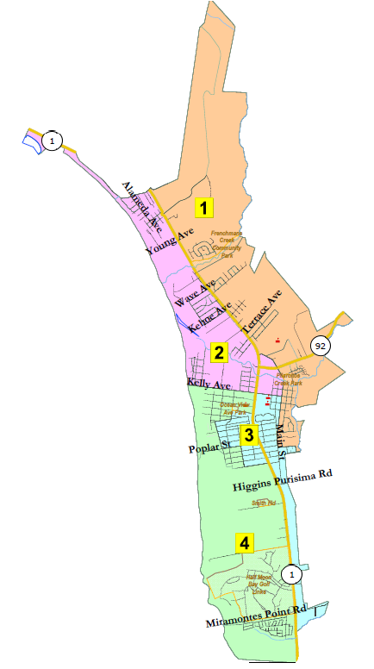
City of Half Moon Bay Redistricting Map Adoption
National Demographics Corporation

Slide 2
Preferred Map
Preferred Map Identified on 1-19-2022:
Map 504c (full version or detail, demographics)
Focus Maps Identified on 12-16-2021 (in ranked order):
5-District Plans
Map 504c (full version or detail, demographics)
Map 503b (full version or detail, demographics)
4-District Plans
Map 402 (full version or detail, demographics)
Map 403b (full version or detail, demographics)
The most detailed way to view maps is with the interactive map viewer at: https://arcg.is/1STi8P0

Slide 3
Map Summary
5-District Plan Ideal Pop: 2,363 | # of Ds | Pop Dev | Max Latino CVAP | Max Non-White CVAP | Pop Bal | Pop Deferred to 2024 | Voters Deferred to 2024 | Contig | Pairings
Preferred Map 504c | 5 | 7.32% | 26.54% | 35.47% | Yes | 1,351 | 993 | Yes | 0
Focus Map 503b | 5 | 7.36% | 27.62% | 36.60% | Yes | 843 | 695 | Yes | 0
4-District Plan Ideal Pop: 2,954 | # of Ds | Pop Dev | Max Latino CVAP | Max Non-White CVAP | Pop Bal | Pop Deferred to 2024 | Voters Deferred to 2024 | Contig | Pairings
Focus Map 402 | 4 | 3.52% | 23.63% | 32.47% | Yes | 1,493 | 1,229 | Yes | 1
Focus Map 403b | 4 | 6.47% | 23.63% | 32.47% | Yes | 1,498 | 1,202 | Yes | 1
Note: Canada Cove total population 580; registered voters 451.

Slide 4
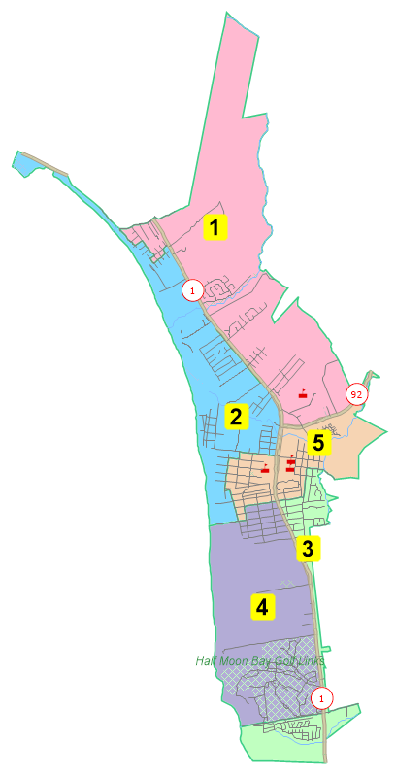
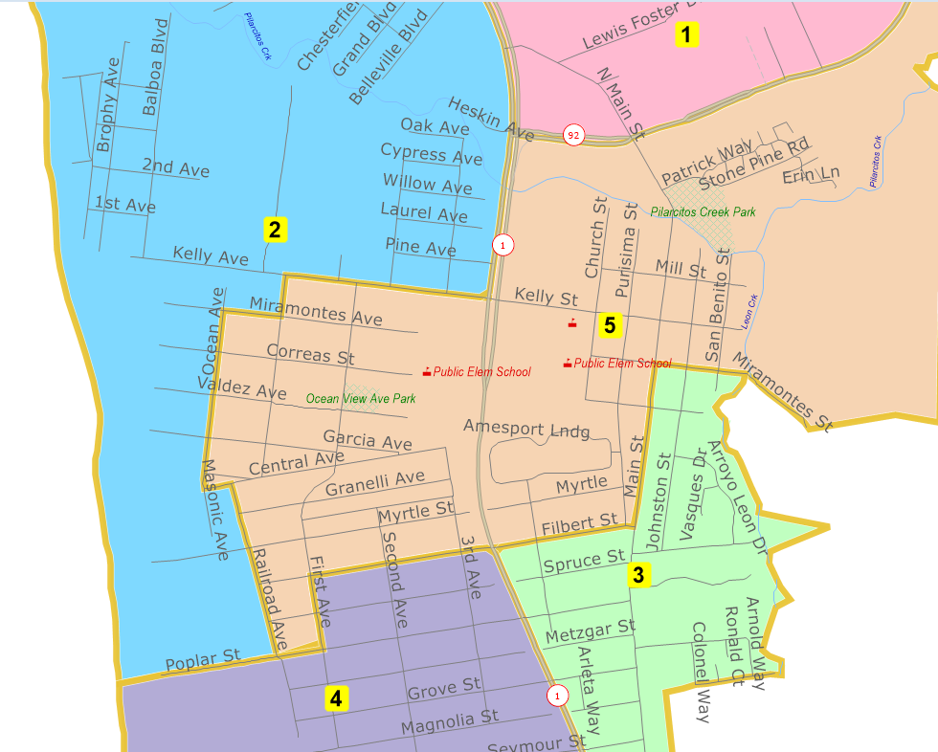
Preferred Map 504c

Slide 5
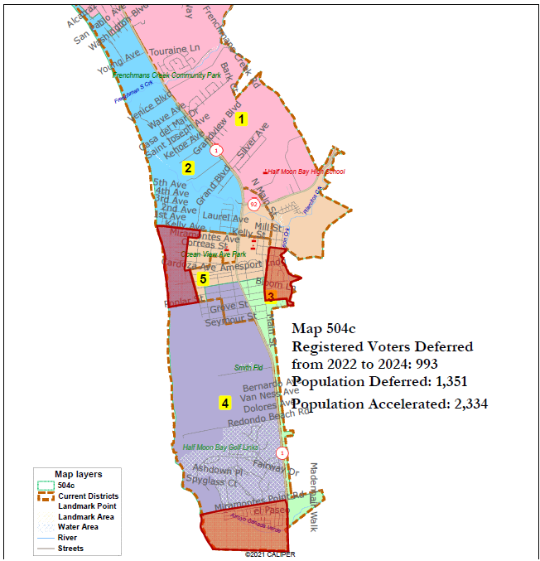

Slide 6
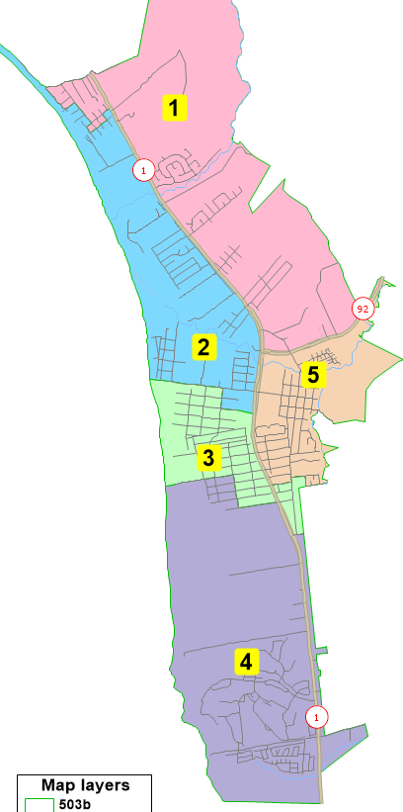
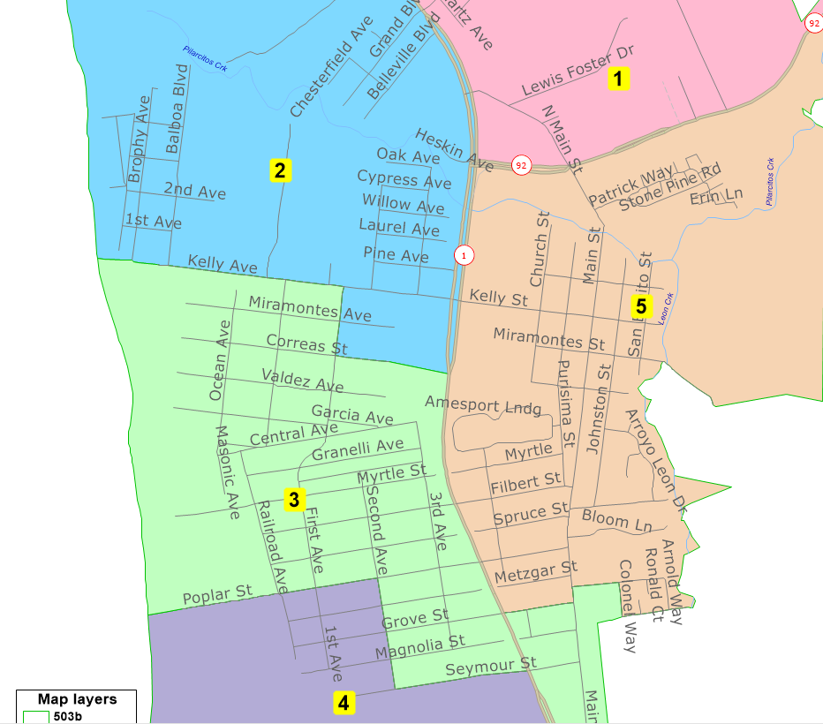
Map 503b

Slide 7
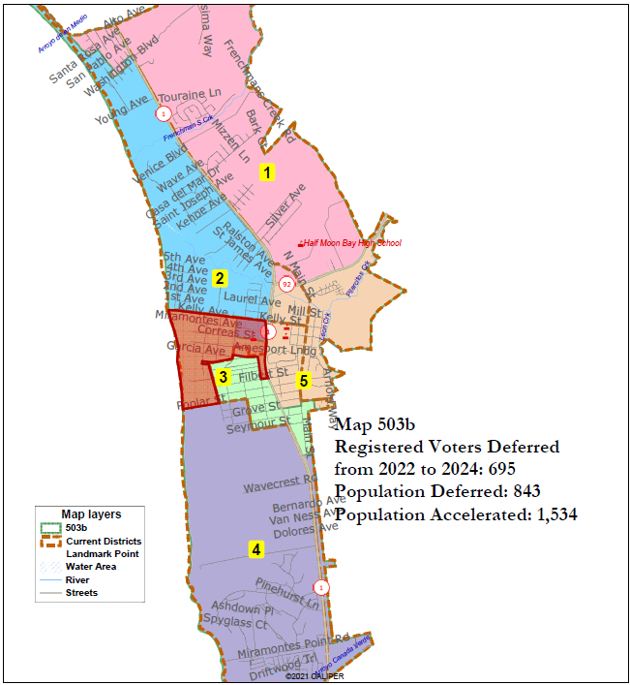

Slide 8
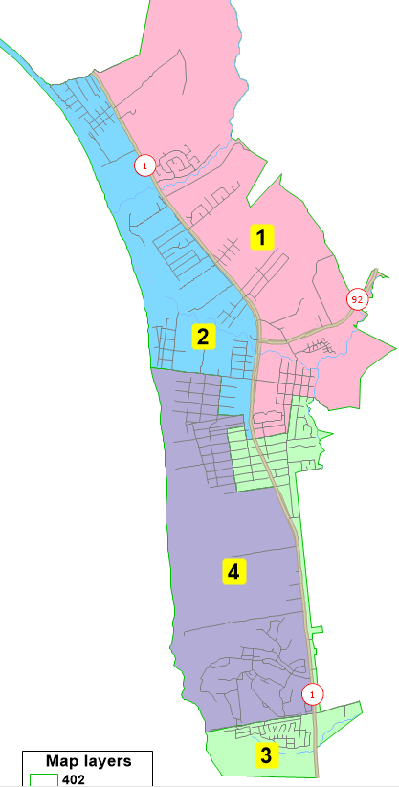
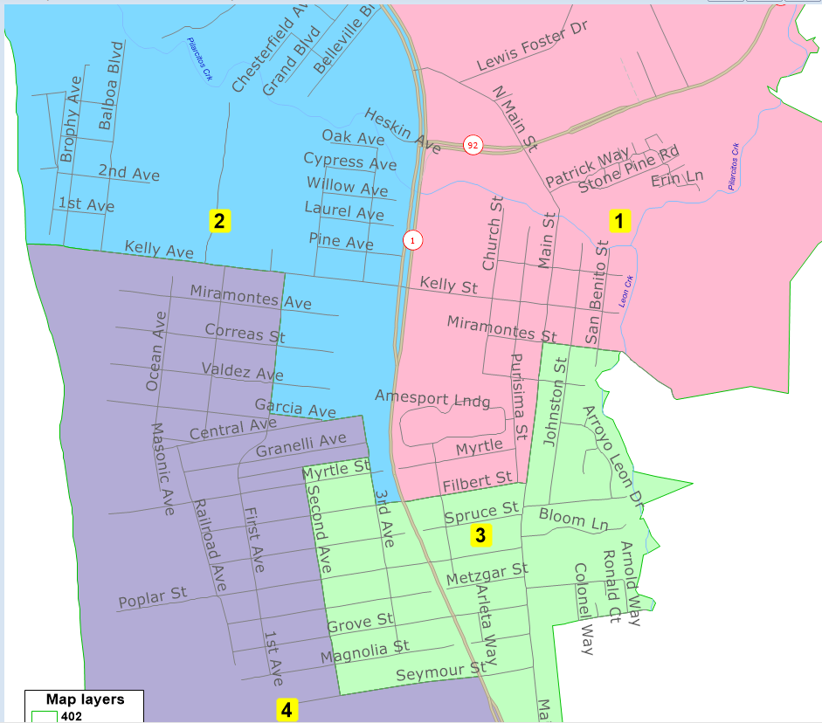
Map 402

Slide 9
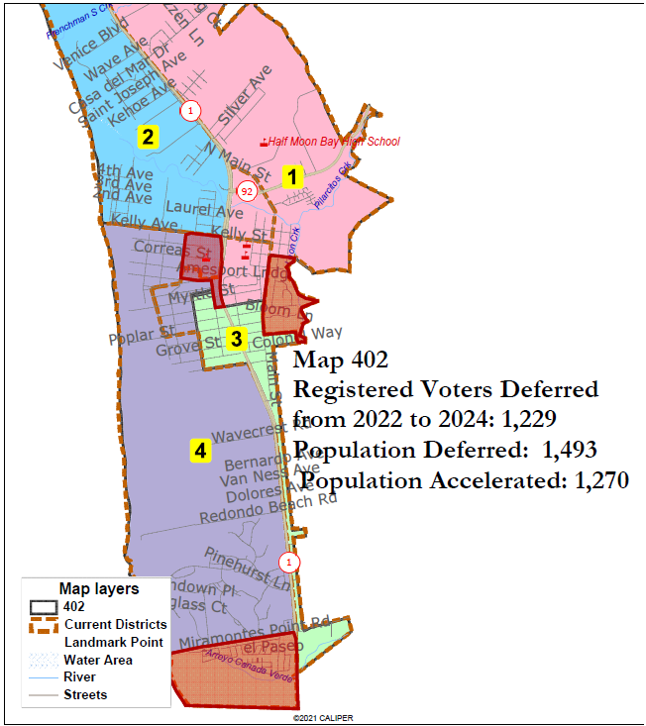

Slide 10
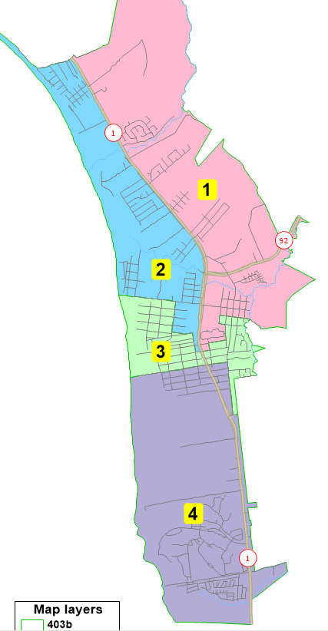
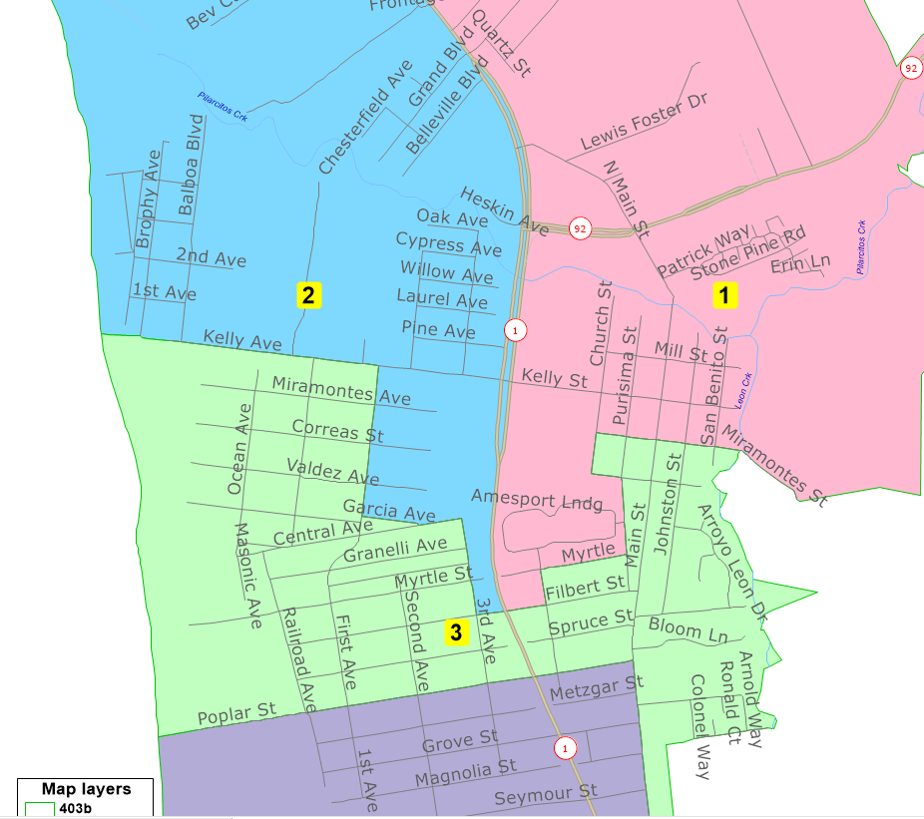
Map 403b

Slide 11
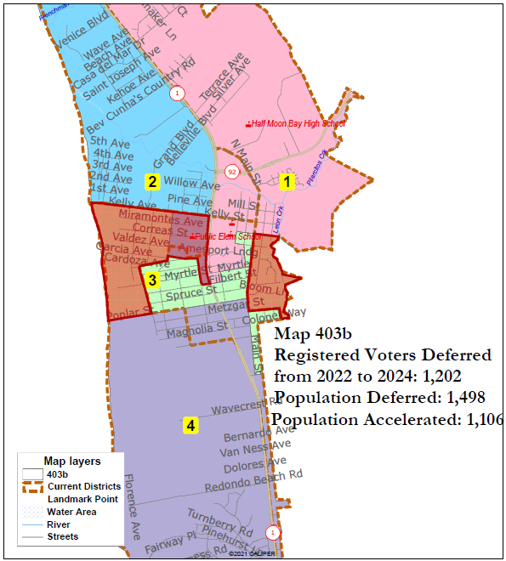

Slide 13
Proposed Sequencing
Election Year 2022: Districts 1, 4, and 5
Election Year 2024: Districts 2, 3
This sequencing will repeat until such time the City is required to redraw its district boundaries, which is expected following the 2030 U.S. Census.

Slide 14
Recommended Action
Identify a preferred map for adoption.
Vote on introduction of an ordinance to adopt the final council boundary map.
Or, alternatively, direct staff as necessary.

