Slide 1
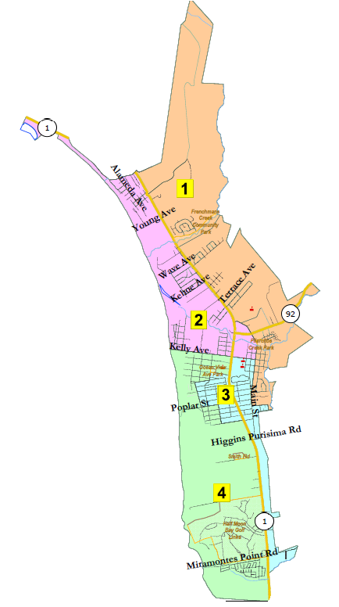
City of Half Moon Bay Redistricting Draft Maps
Redistricting Advisory Committee
Marin Holt, Chair
Paul Gater, Vice Chair
Hal Bogner, Committee Member
Steve Maller, Committee Member
Claudia Marshall, Committee Member
Phil Marshall, Committee Member
Michal Settles, Committee Member
National Demographics Corporation

Slide 2
 | REDISTRICTING ADVISORY COMMITTEE Marin Holt, Chair Paul Gater, Vice Chair Hal Bogner, Committee Member Steve Maller, Committee Member Claudia Marshall, Committee Member Phil Marshall, Committee Member Michal Settles, Committee Member
Jul. – Sept. | Committee held a series of workshops and two pre-map public hearings to review redistricting statutes and process, mapping tools, and communities of interest. Committee discussed the differences between a 4-district model (directly-elected mayor), and a 5-district model (rotating mayor).
Nov. 8 | Public hearing held by the committee to review draft maps. Nine 4-district maps Ten 5-district maps. Maps were drawn based on estimated population data and were not population balanced. The Committee considered the themes and communities of interest conveyed in submitted maps and extended the map drawing deadline to November 26.
Dec. 16 | Public hearing held by the committee to review draft maps. Eight 4-district maps (two were not population balanced) Nine 5-district maps (one was not population balanced, three were not contiguous) The Committee reviewed maps, census block geography, and demographic summaries and directed the creation of Map 504c (based on Map 504b) to keep the Casa del Mar and Oak Park communities undivided. The committee selected four draft maps: 504c, 503b, 402, 403b (ranked order) The committee expressed preference for the 5-district model.

Slide 3
Step | Description
Workshops (RAC) Aug. 12 & Aug. 19 | Education and to solicit input on the communities in the Districts.
Two Pre-Map Hearings (RAC) Aug. 26 & Sept. 2 | Held prior to release of draft maps. Education and to solicit input on the communities in the Districts.
Census Data Release Aug. 12 | Census Bureau releases official 2020 Census population data. The data will be in legacy format and must be reformatted.
California Data Release Sept. 20 | California Statewide Database releases ‘prisoner-adjusted’ 2020 redistricting data, then three-week waiting period to release maps.
Review Draft Maps (RAC) Nov. 8 | Review and revise the draft maps and to select focus maps.
Map Submission Deadline Nov. 26, 5 p.m. | The City’s demographer will professionally produce submitted maps and prepare a demographic summary for each map.
Review Draft Maps (RAC) Dec. 16 | Review and revise the draft maps and to select focus maps.
Post-Map Hearing (CC) Jan. 19 | First public hearing to discuss and revise the draft maps and to discuss the election sequence.
Workshop (RAC) Jan. 27 | Solicit input on focus maps. Any proposed revisions to focus map must be received by Feb. 4.
Post-Map Hearing (CC) Feb. 15 | Second public to review proposed map(s) and introduce an ordinance to adopt a map.
Map Adoption (CC) Mar. 15 | Final map must be posted at least 7 days prior to adoption. Map adopted via ordinance. Deadline to adopt: Apr. 17, 2021

Slide 4
Communities of Interest
Canada Cove with other senior housing. Frenchman’s Creek with northern district. Oak Park undivided. Alsace Lorraine with Ocean Colony Arleta Park Household Income Renters v. Owners Downtown Senior Communities Traffic Issues

Slide 5
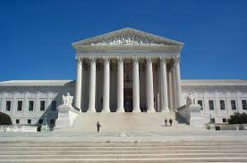
Redistricting Rules and Goals
1. Federal Laws
2. California Criteria for Cities
3. Other Traditional Redistricting Principles
Equal Population
Federal Voting Rights Act
No Racial Gerrymandering
Geographically contiguous
Undivided neighborhoods and “communities of interest” (Socio-economic geographic areas that should be kept together)
Easily identifiable boundaries
Compact (Do not bypass one group of people to get to a more distant group of people)
Prohibited: “Shall not favor or discriminate against a political party.”
Minimize voters shifted to different election years
Respect voters’ choices / continuity in office
Future population growth
Preserving the core of existing districts

Slide 6
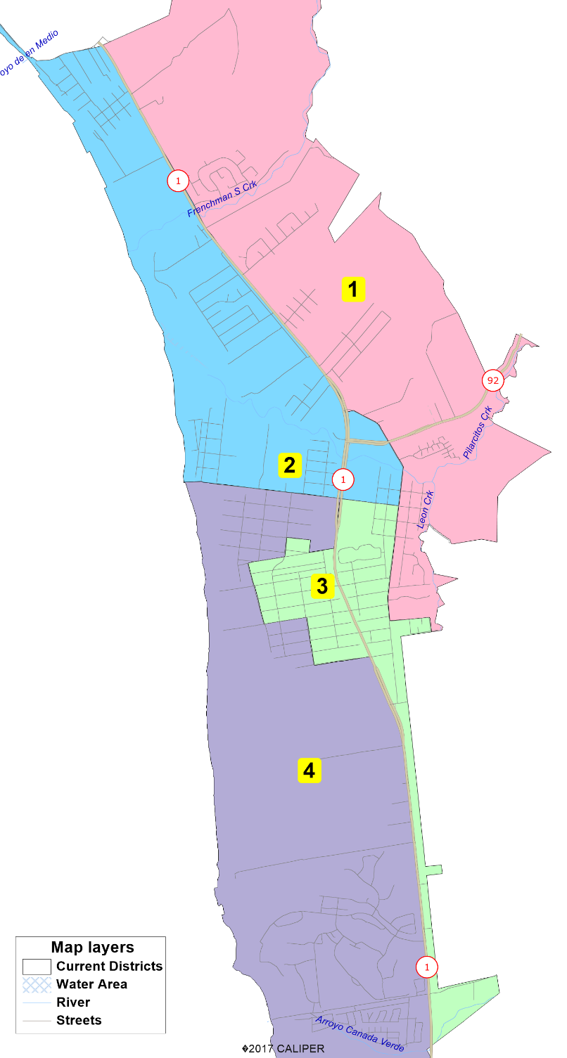
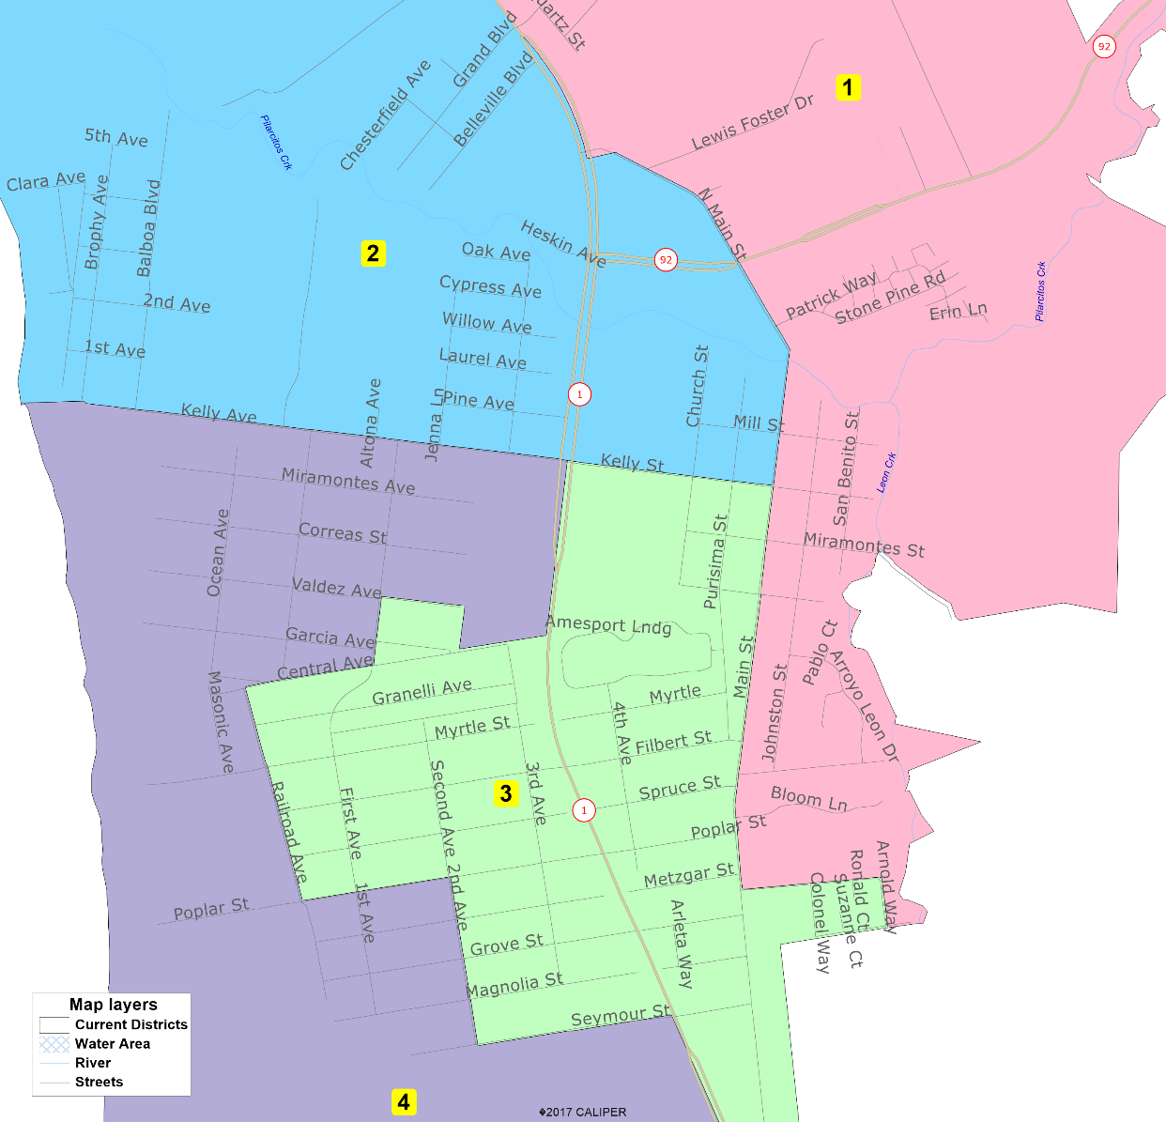
Current Districts

Slide 7
Demographic Summary of Existing Districts
Official California-Adjusted 2021 Redistricting Data
Only required change is about 200 people out of District 4 into Districts 2 and 3.
Notes:
2020 Legacy: 11,795
11,795 5 2,359
11,795 4 2,949

Slide 8
Preferred Map
Preferred Map Identified on 1-19-2022:
Map 504c (full version or detail, demographics)
Focus Maps Identified on 12-16-2021 (in ranked order):
5-District Plans
Map 504c (full version or detail, demographics)
Map 503b (full version or detail, demographics)
4-District Plans
Map 402 (full version or detail, demographics)
Map 403b (full version or detail, demographics)
The most detailed way to view maps is with the interactive map viewer at: https://arcg.is/1STi8P0

Slide 9
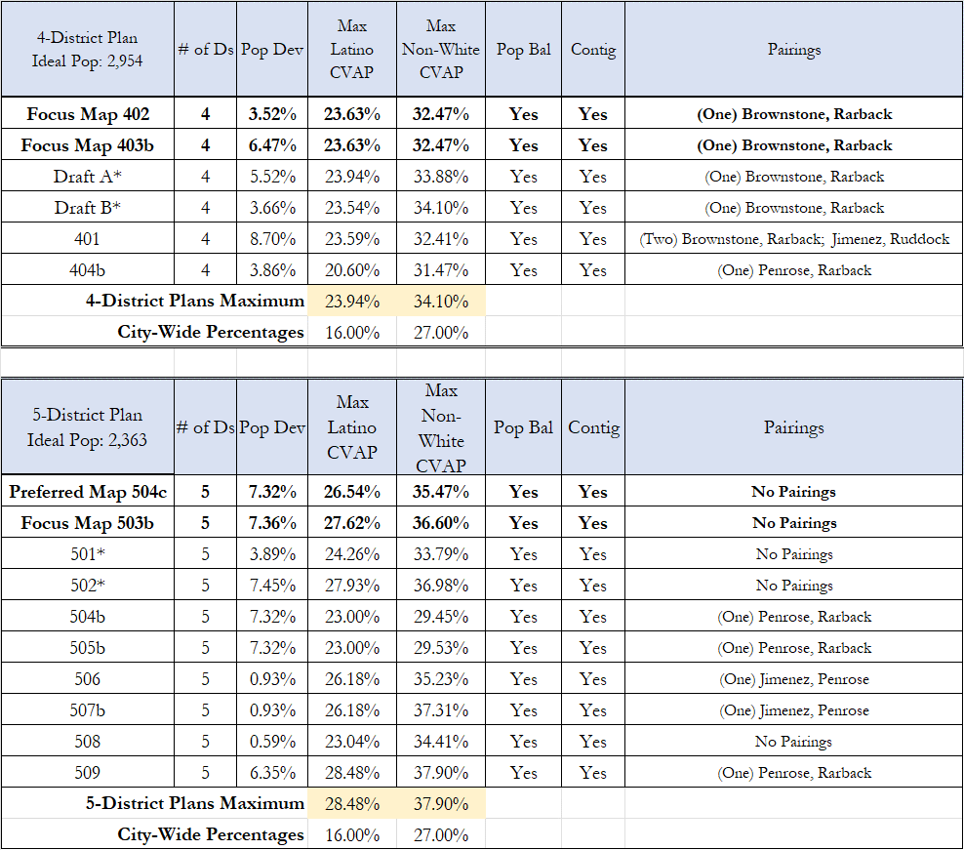

Slide 10
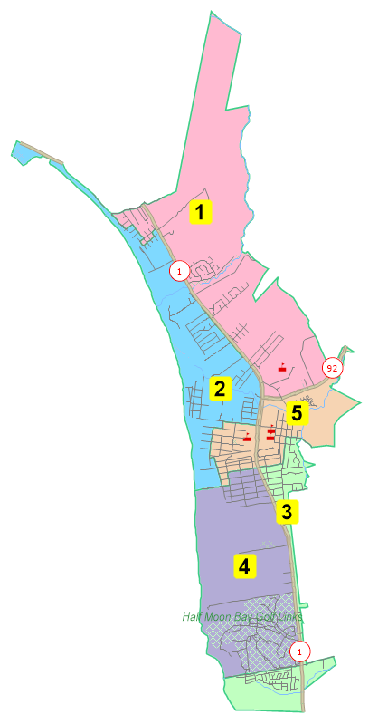
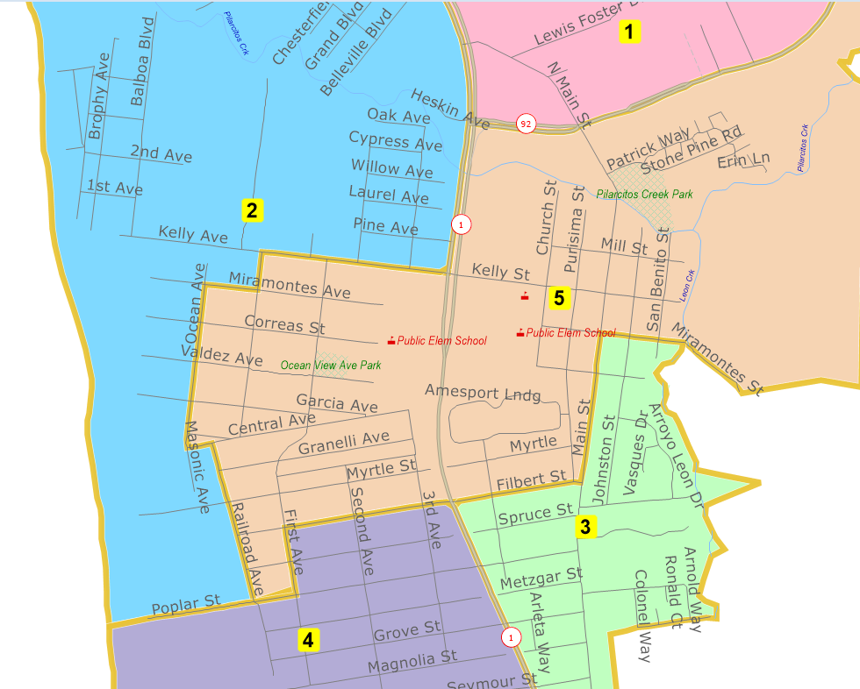
Preferred Map 504c

Slide 11
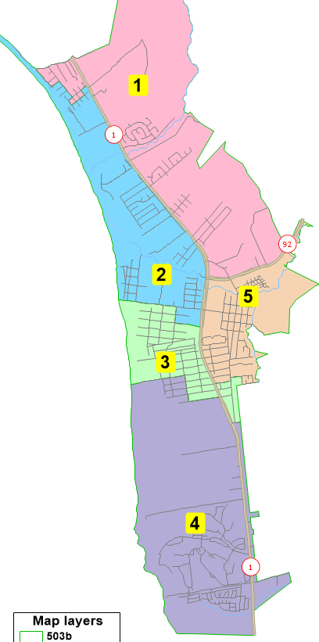
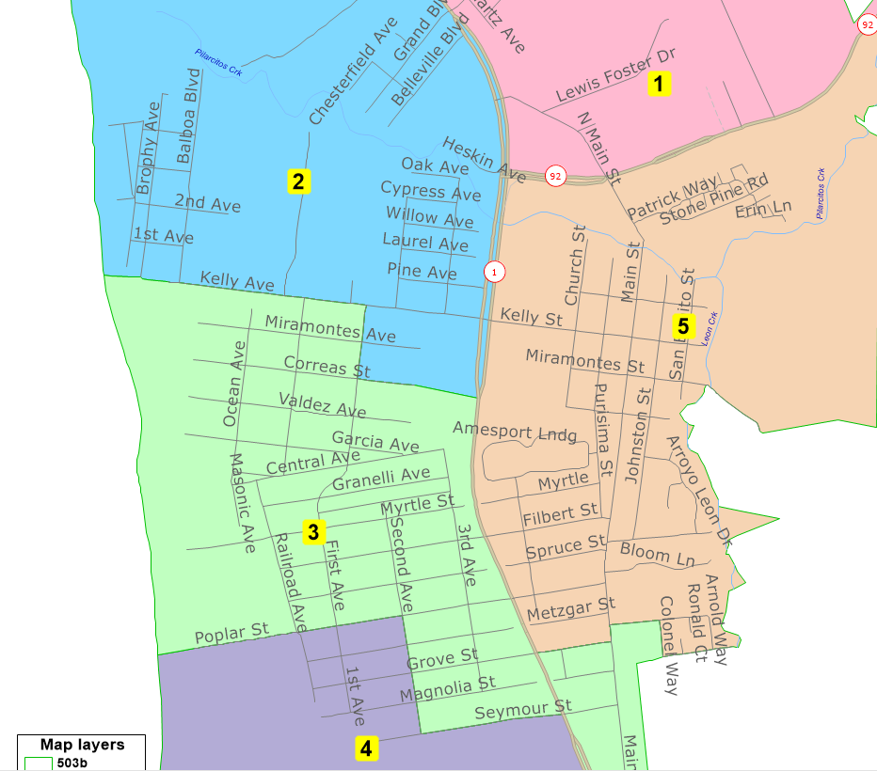
Map 503b

Slide 12
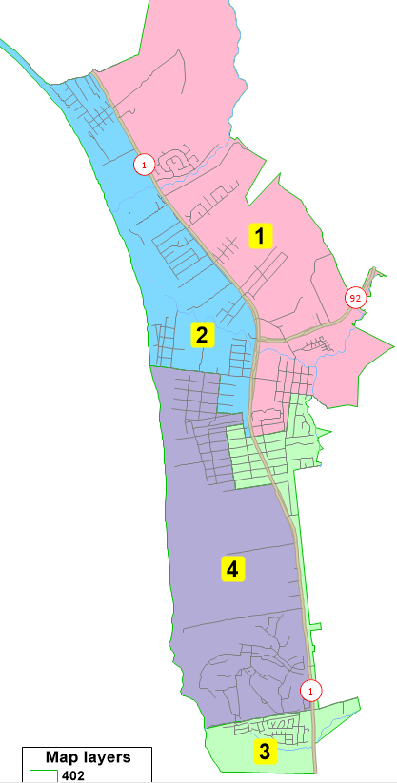
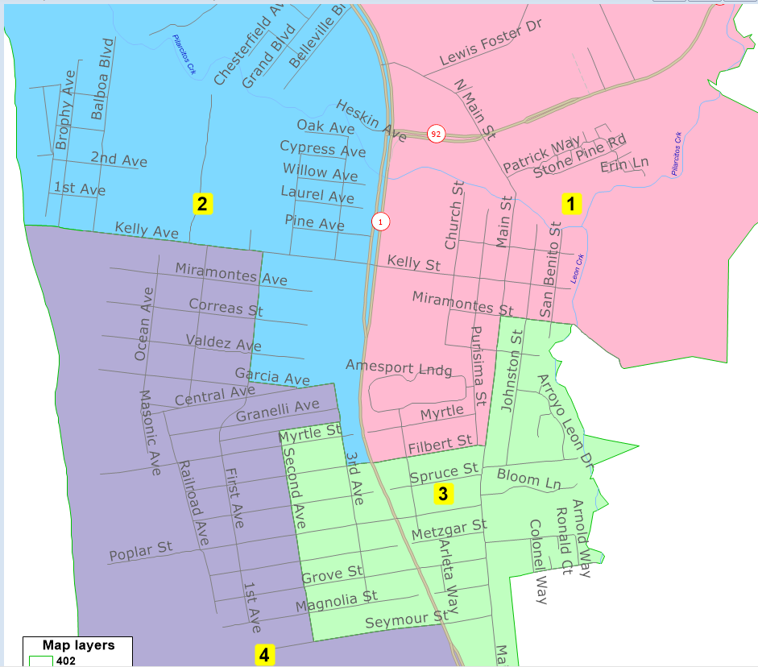
Map 402

Slide 13
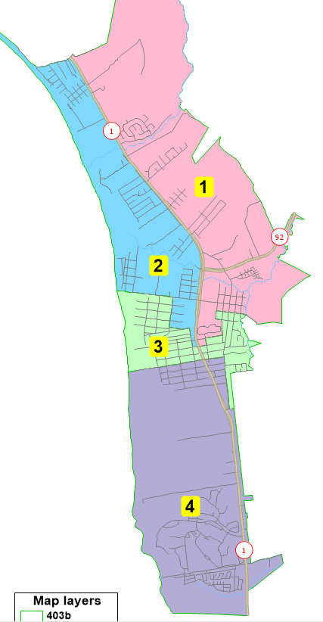
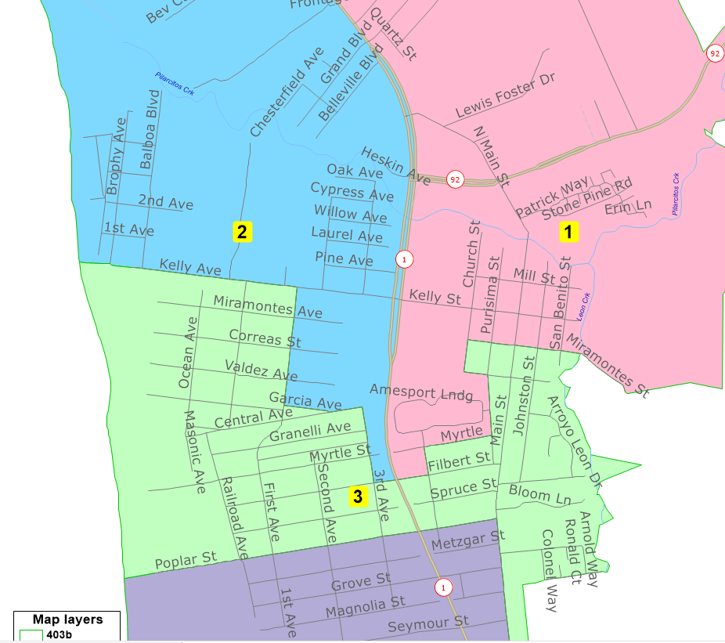
Map 403b

Slide 14
Current Districts

Slide 15
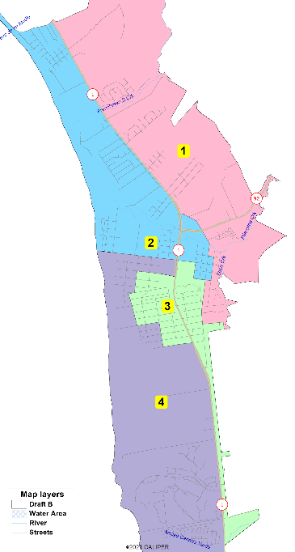
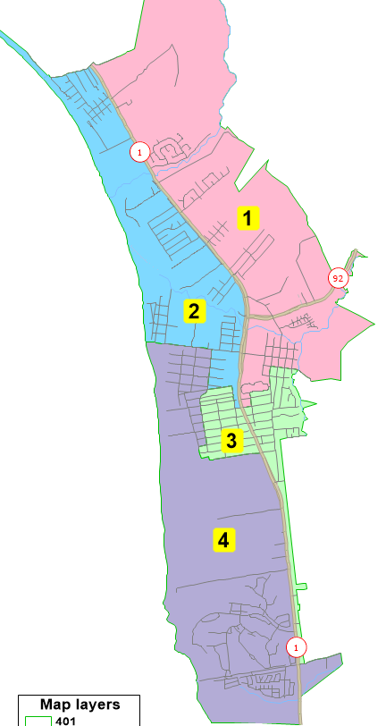
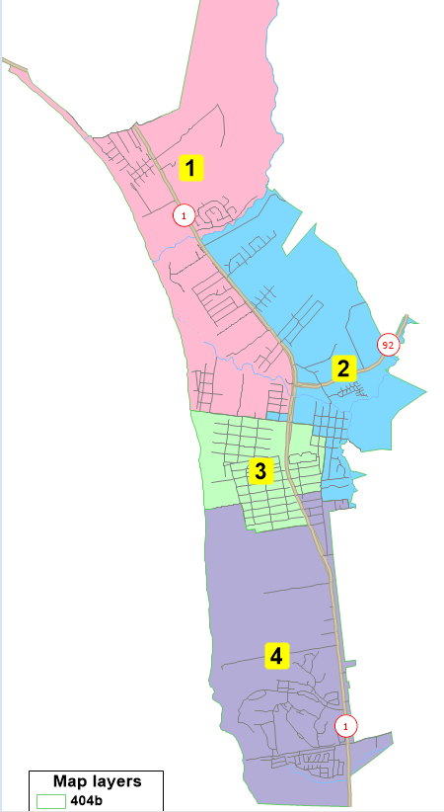
Not Population Balanced
Map 401
Current Districts
NDC 4-District Draft A
NDC 4-District Draft B
4-District
Plans
Map 402
Focus Map
Map 403b
Focus Map
Map 404b

Slide 16
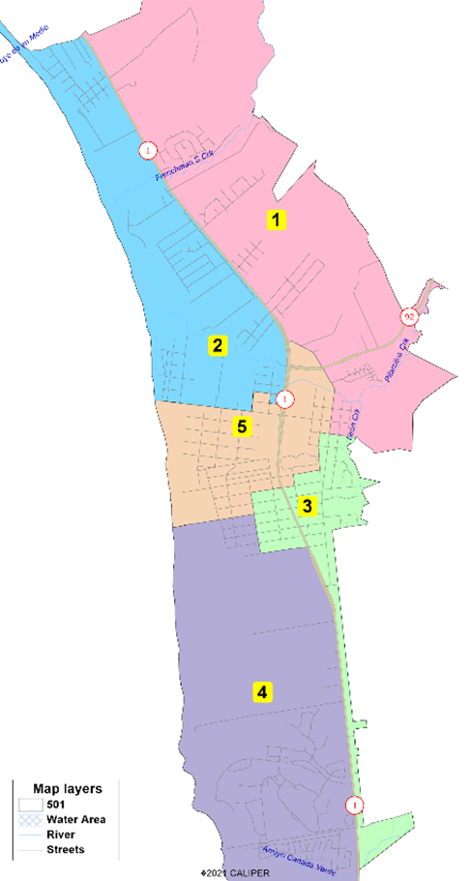
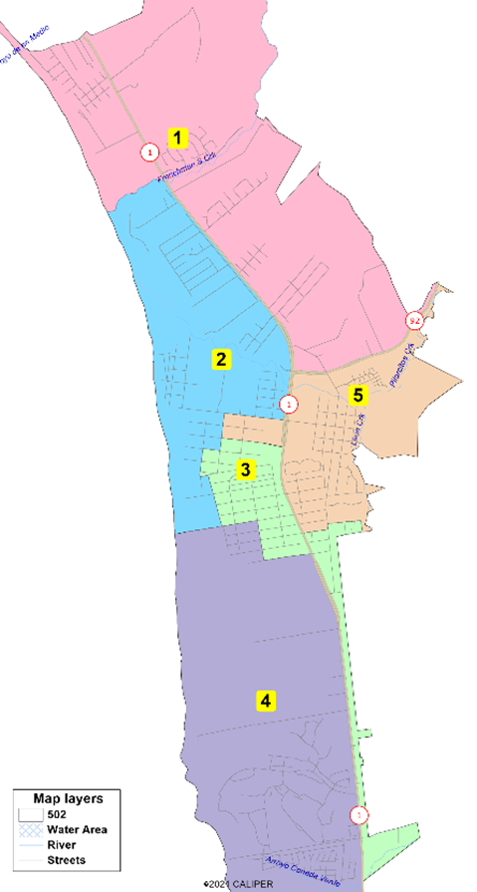
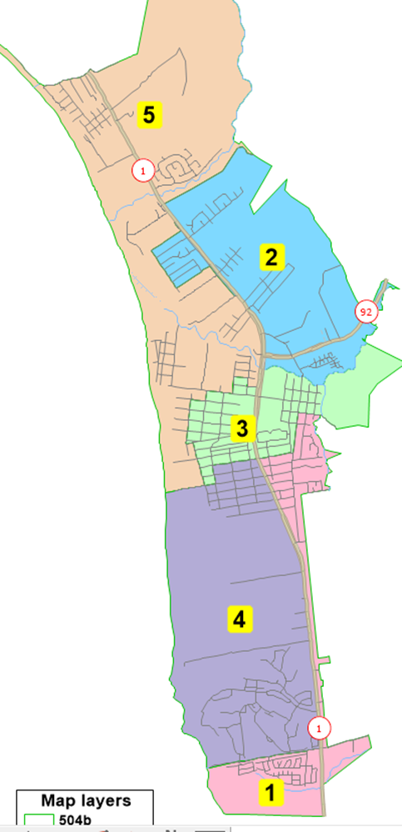
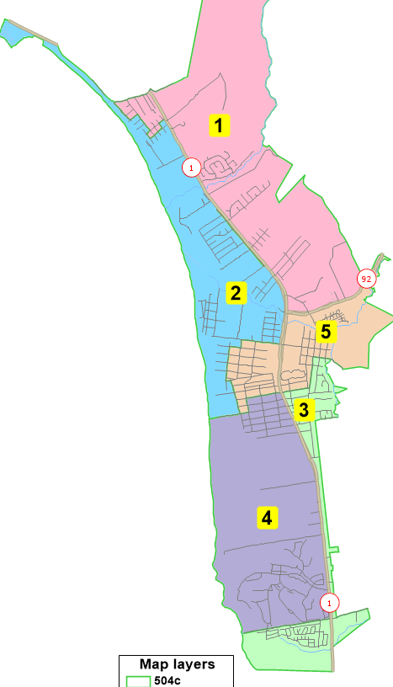
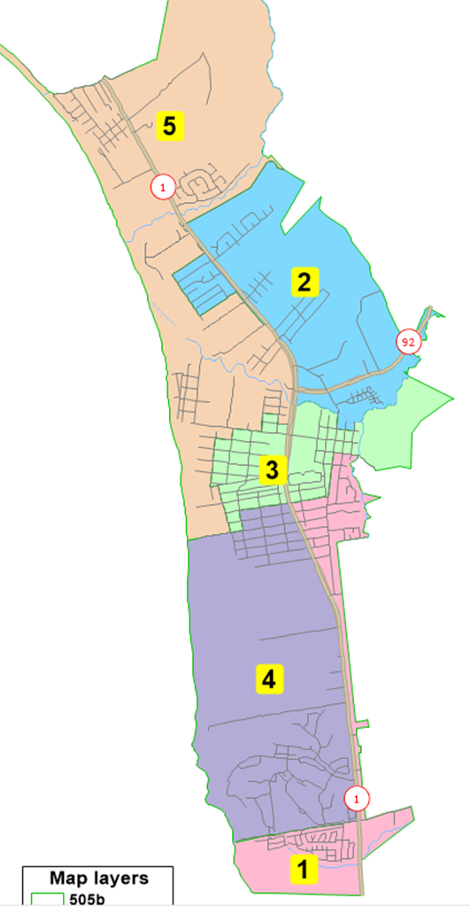
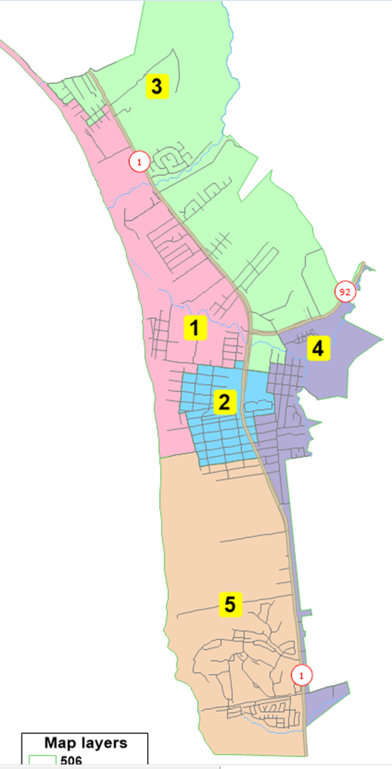
NDC 5-District Alternative 501
NDC 5-District Alternative 502
Map 503b
Focus Map
Map 504b
5-District
Plans
Map 504c
Preferred
Map
Map 505b
Map 506

Slide 17
Proposed Sequencing
Election Year 2022: Districts 1, 4 (and 5 if 5-districts)
Election Year 2024: Districts 2, 3
After focus maps are identified, it is recommended the City Council and Committee review and, if needed, adjust the district number assignments.

Slide 18
DrawHMB.org

